Slide 1
Magic Syntax for NPR Report Writers
Presented By:
Joe Cocuzzo
Sr VP, Reporting Services
MUSE 2015 Workshop

Slide 2
About Magic
Proprietary offshoot of MUMPS (a/k/a “M”)
Developed by Dr Octo Barnet with help from A. Neil Papalardo at Mass General.
Designed to be a lightweight language particularly suited for string (text) data.
Popular for Medical applications: Sunquest, Cerner, IDX, EPIC

Slide 3
Meditech – Now in Four Flavors
Magic - Proprietary OS / Magic Language
C/S - Windows OS / Magic Language
a/k/a VMagic
FS - “Functional System”
(C/S platform, EMR & PCS)
FOCUS - M/AT “6.x”
6.0 EMR, ER PCS, POM, OE move to FS w/ toolset PCS data NOT returned to C/S. 6.1 financials and administratives move also

Slide 4
New Tools..
New “Focus” Report Designer (RD)
Goals.. “no code required”
Achievement.. “no coding allowed!”
Reports from FOCUS and C/S applications.
C/S Vmagic can get data from FOCUS w/ some complicated programming…

Slide 5
Fundamentals of Magic
LEFT to RIGHT evaluation
Everything is a string
Value = True
No Value (nil) = False
Powerful string operators (like MUMPS)
Weak math skills
10+2*5= 60 (!) 5/10 = 0 (!)

Slide 6
Fundamentals - Continued
Data automatically stored in “tree”
*AA[aa] = data
Data automatically sorted by subscripts
No need for searching or sorting algorithms
Global
Subscript
Prefix

Slide 7
More Fundamentals (weaknesses)
Variable name + string < 256 in length
Lines of code < 256 in length
(Magic Only)
1K for variables and their values across all programs in session unless you “stack symbol table”

Slide 8
Symbol Table
In Magic..
1024 bytes is all you get
Unless..
%ADM.PAT.zcus.is.your.macro.M.do(urn)X
You get space back when you nil a variable

Slide 9
Symbol Table continued
Symbol table limit applies to local variables only: STUFF, x, y, aa
Not to “slash variables”
/STUFF b.dis.date e.dis.date @.user
b.dis.date translates to /b.discharge.date
@.user translates to /.USR

Slide 10
FILES
Sequential Access Files vs
Random Access Files
SAF – Spool File, RAD editor text file
RAF – All data and dictionary files

Slide 11
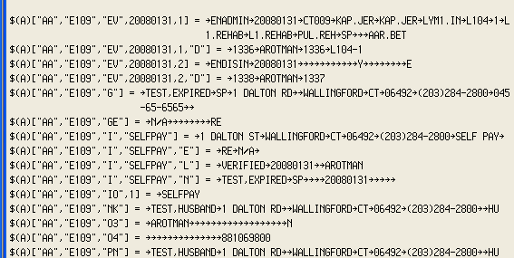
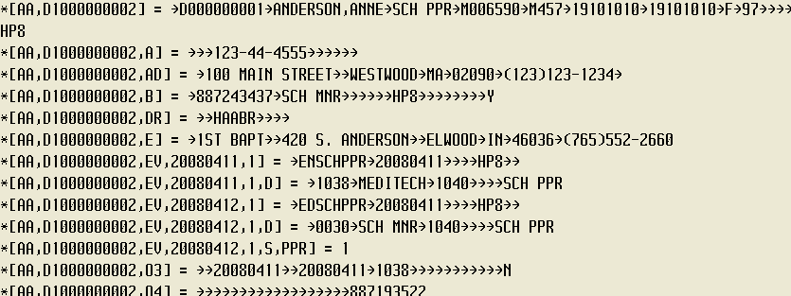
Look at Data

Slide 12
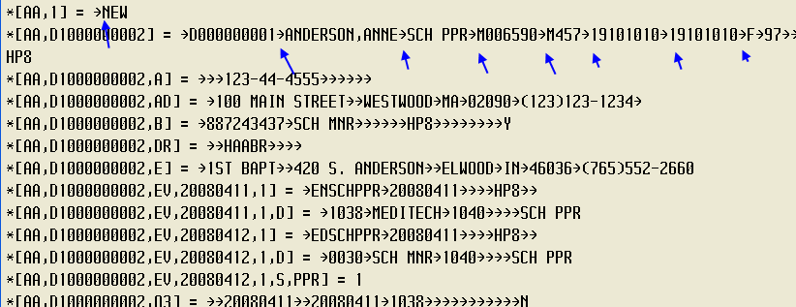
What are these:
Data is “packed” or “queued”

Slide 13
How to make these yourself?
Q(“FIRST”,”SECOND”,”THIRD”)^STUFF
STUFF|0 = FIRST
STUFF|1 = SECOND
STUFF|2 = THIRD

Slide 14
Alternative Syntax
{“FIRST”,”SECOND”,”THIRD”}^STUFF
“THIRD”^STUFF|2
Add quotes automatically..
`FIRST,SECOND,THIRD’^STUFF

Slide 15
Get data back out
STUFF = FIRST^SECOND^THIRD
STUFF|0=FIRST
STUFF|1=SECOND
STUFF|2=THIRD
STUFF^{A,B,C}
A=FIRST, B=SECOND, C=THIRD

Slide 16
So.. Magic is an easy language
String operators
IF syntax
@Next, @Prev, + and –
DO syntax
-----------------
Magic – Prefix management/Looping
C/S – Opening Database/Looping

Slide 17
String Operators
# string at the position ABC#1 = B
$ to the left YYYYMMDD$4= YYYY
% to the right YYYYMMDD%5 = DD
‘ = not
ABC’#1 = AC

Slide 18
String Operators
YOURSTRING
0123456789
YOURSTRING#3 = R
YOURSTRING%3$3 = STR
YOURSTRING’#3 = YOUSTRING

Slide 19
What is it good for?
ER admissions by hour of the day:
xx.hour
DAT=INT
LEN=2
VAL=@service.time$2+0

Slide 20
Parsing Strings – invented delimiter
“BERMAN,JOEL F”#”0,” = BERMAN
“BERMAN,JOEL F”#”1,” = JOEL F
“BERMAN,JOEL F”#”1,”#”0<space>” = JOEL

Slide 21
Parse Mnemonics
Mnemonics:
NUR.COCJ#”0,” = NUR
IS.SMIF#”0.” = IS
PURC.JOE#”0.” = PURC

Slide 22
Strip SSN of dashes
NNN-NN-NNNN’#3’#5
NNN-NN-NNNN’#3 = NNNNN-NNNN
01234567890
NNNNN-NNNN’#5
0123456789
(‘~ for general stripping)

Slide 23
Magic Math
Left to Right – no precedence of operation
Decimal Precision:
+ - * places = operand w/ most places
/ decimal places in numerator – places in denominator:
5/10 = 0 (zero places – zero places = zero)
5.0/10 = 0.5 (1 place – zero places = 1 place)

Slide 24
Magic Math Rule Of Thumb
X * 1.00000000000/Y :2D
Give X lots of places, then round with
:nD n = desired number of places with
5/4 rounding

Slide 25
More punctuation… “:”
: = format operator
:nD = round to n decimals
:nT = truncate to n characters
:nTL = truncate to n characters, left pad
:nTR = truncate to n characters, right pad
For zero padding:
%Z.zero.fill() see your mouse pad for details

Slide 26
Lost your mouse pad..
Look at MT source code:
Magic F(4) \Name of Program
C/S F(5) DPM, then procedure
Lookup available
Arguments usually at top of program

Slide 27
Copy MT Macros
INIT report from standard..
“The more you need it, the less likely it is to work”
List report to paper
Create report w/ same selects/segments
Copy Macros w/ F(4) Magic
Exact name match needed in Magic
F(5) C/S
Put “M” at procedure prompt in C/S

Slide 28
Syntax issues
Take @ sign out of @Next subscripts
DO{@Next(@dx) change to @Next(dx)
Loop instead of Killing
K(/STUFF) @Kill(/STUFF) $K(^/STUFF)
DO{>/STUFF[SUB]^SUB “”^/STUFF[SUB]}

Slide 29
Syntax issues continued
Writing to @
141^@Z.last.key
Change to
141^/Z
Writing to /.
1^@.pha.site
".PHA.SITE"^XXX, 1^/[XXX]

Slide 30
IF syntax
IF{condition<space>statement}
IF{condition<space>statement;
Nextcond<space>statement;
Nextcond<space>statement;
Finalvalue}

Slide 31
IF Syntax
IF{@age.in.years^AGE<18 "Child";
AGE<65 "Adult";
AGE "Senior";
"No Age Available"}

Slide 32
Things that mess up IF
Left hand value returned if comparison is true
Nil returned if comparison is false
Forgetting LEFT TO RIGHT (!)
Not knowing that:
! = maximum (not really OR)
& = minimum (not really AND)

Slide 33
IF failure
IF{@age.in.years^AGE<18!AGE>65 "Y"}
IF{17<18!17>65 "Y"}
IF{17!17 returns 17
IF{17>65 "Y"} fails
Solution: Add Parenthesis
IF{@age.years^AGE<18!(AGE>65) "Y"}

Slide 34
+ and -
+ = most essential operator in Magic
Moves thru structures one subscript level at a time
List next doctor (or first if DOC var is initially nil)
+\GU[DOC]^DOC

Slide 35
Sense of +
+ pushes subscript into variable
Value of this expression goes from first doctor to last doctor, then to nil
+\GU[DOC]^DOC

Slide 36
Add A Do
Combine + and DO and you have a report writer
DO{+\GU[DOC]^DOC N(DOC)^#}

Slide 37
Syntax of DO
DO{while.true<space>DOSTUFF}
So list Doctors from start to "C"
DO{+\GU[DOC]^DOC<"D" N(DOC)^#}

Slide 38
Report Example – List LI vals
Loop on c.inpatient.location, build list of locations in string and print on report
ADM.PAT.zcus.is.muse2015.loop.on.location

Slide 39
@Next
Difference between + and @Next
@Next is for structures in the Data Definition
@Next(dx)
@Next(room,@room.bed.index)

Slide 40
@Next
@Next uses data definition to figure out the subscripts and structure to loop on:
@Next(dx)
+?DZ[dz]DX[dxN]^dxN
@Next(bed,@room.bed.index)
+:AARB[ggb,ggrB]^ggrB]
@Next(subscript) or @Next(subscript,index)

Slide 41
Report Example
Scheduled and Registered Patients on Same Report
Loop on Registration Index AND
Loop on Scheduled Index "yourself"
Put urns into list in slash
ADM.PAT.zcus.is.muse2015.sch.and.reg

Slide 42
“Next Get” syntax
+(/STUFF[SUB],DATA)^SUB
+ on subscript and get value of node in one operation
@Next.get(bed,@room.bed.index,urn)

Slide 43
Report Example
Current Patients on NUR Report
Bonus
Skip Undo
Post – Edit Values Only

Slide 44
Physical Next/ Physical Previous
>:AARB[SUB]^SUB
>@room.bed.index[SUB]^SUB
SUB#0S = facility
SUB#1S = room
SUB#1S = bed
You can use > in Next Get syntax
>(@room.bed.index[SUB],DATA)^SUB

Slide 45
Physical Nexting
There is also physical previous (<)
No translator operator for > and <
ie nothing like: @Phys.Next(STUFF)

