Slide 1
Meditech Data Repository: What is it, and how do I use it? Part 2 (SSRS)
Presented By:
Myles Britten
5/26/2015

Slide 2
Introduction
Myles Britten
DR Programmer/Analyst with Iatric Systems Reporting Services
Seven + years of Meditech DR SQL experience
Sixteen years hospital IT experience
Fifteen years of business/one + years clinical reporting experience with Home Grown (AS/400), Lawson, and Meditech at hospital

Slide 3
Covered topics
During this training session, the following topics will be covered
Overview of what the DR actually is
Overview of SQL Server Reporting Services
Overview of BIDS/SQL Server Data Tools
Creation of report using the reporting tool
Overview of visual abilities of reports
Review using code behind (VB) to handle specialized tasks
Overview ability to stylize reports based on configuration tables and variables

Slide 4
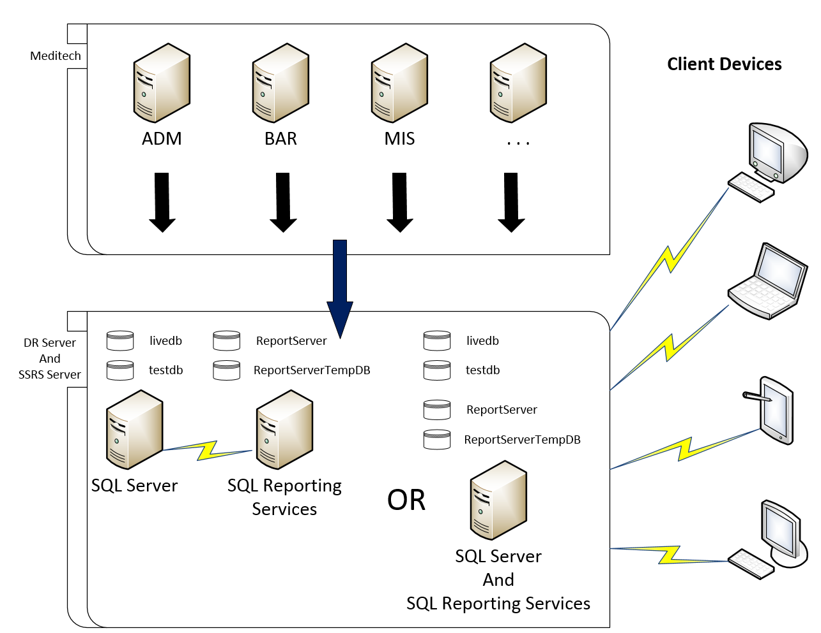
DR Overview Diagram

Slide 5
DR Overview DR XFER Process
The DR XFER process sends data from the Meditech system to the Data Repository.
Each Meditech server has activity logs. These records are continuously updated when a new record is created, modified or deleted in the Meditech system.
Activity logs are monitored for changes by a service running on each server. The process creates an equivalent SQL statement for each transaction and sends the data to the Data Repository.
Each application has its own queue and all transactions are sent down the same pipe line to the DR.
Notes:
The DR XFER process: http://www.meditech.com/prdr/Pages/DRxbASTransferMechanism.htm

Slide 6
DR Overview DR XFER Process
There are two types of transfer modes.
Batch Mode is typically run once per day and sends the previous days transactions to the DR Server. This can leave the DR out of sync by over 24 hours.
Continuous Mode continuously streams transactions to the DR Server. This is the most common of the two. Delays can be as little as a couple of minutes but not usually more than 15 minutes.
Although infrequent, two types of errors can occur for the continuous mode. Non-fatal and fatal. A non-fatal error will prevent a record from crossing over to the DR and a fatal error will crash the transfer process.
If you notice that there is missing data or it appears that nothing has come across for some time, open a Meditech support ticket to send the missing record or restart the transfer process.

Slide 7
SQL Server Reporting Services Overview Summary
Reporting Services is a server-based reporting platform that provides a full range of ready-to-use tools and services that help people throughout an organization to create, deploy, manage, and use reports quickly and easily. With Reporting Services, one can retrieve data from a relation data source; publish reports that can be viewed in various formats; and centrally manage report security and subscriptions. The reports that are created can be viewed over a Web-based connection or as part of a Microsoft Windows application or SharePoint site.

Slide 8
SQL Server Reporting Services Overview Report Manager
Report Manager is a Web-based report access and management tool that one uses to administer a single report server instance from a remote location over an HTTP connection. The Report Manager can also be used for its report viewer and navigation features.
Report Manager can be used to perform the following tasks
View, search, print, and subscribe to reports
Create, secure, and maintain the folder hierarchy to organize items on the server
Configure role-based security that determines access to items and operations
Configure report execution properties, report history, and report parameters
Create report models that connect to and retrieve data from a Microsoft SQL Server Analysis Services data source or from a SQL Server relational data source
Set model item security to allow access to specific entities in the model, or map entities to predefined click-through reports that you create in advance
Create data-driven subscriptions that roll out reports to a large recipient list
Create linked reports to reuse and repurpose an existing report in different ways
Launch Report Builder to create reports that you can save and run on the report server

Slide 9
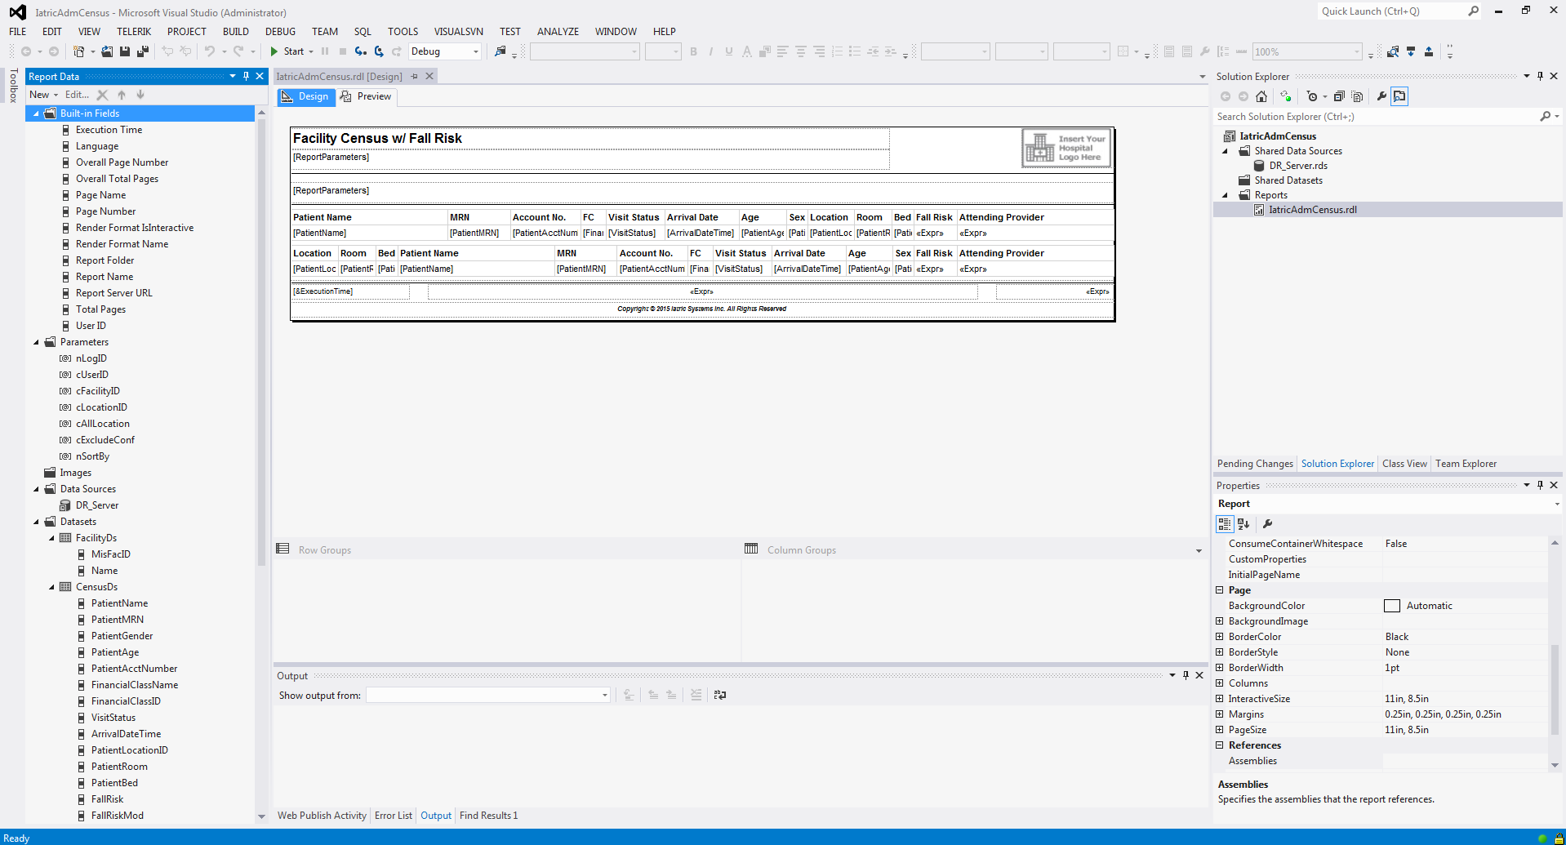
BIDS/SQL Server Data Tools Overview Interface Layout

Slide 10
BIDS/SQL Server Data Tools Overview Summary
Key things to remember about Reporting Services
Reports can be developed in either Report Builder or BIDS/SQL Server Data Tools
Reports are deployed to the users via Report Manager or SharePoint
The Preview in Report Builder or BIDS/SQL Server Data Tools may not exactly match what is displayed in the Report Manager website
SSRS was developed primarily as a report viewer, not a printing system
SSRS can report against any data source you have a drive for
Best practice for report development is to split the data retrieval and data presentation steps into two distinct processes
Build a parameterized stored procedure to retrieve data
Build SSRS report to present the data in a readable form
Don’t build queries in SSRS, they tend to be inefficient
Don’t build groups, crosstabs or graphs in SQL, SSRS excels in this area

Slide 11
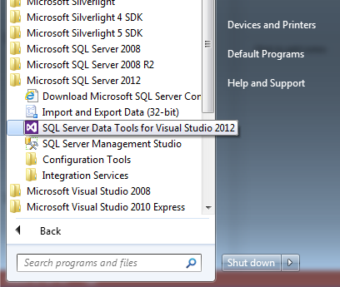
SQL Server Reporting Services Report Create Initial Project
During this training, SQL Server Data Tools will be used to create the reports.
To open SQL Server Data Tools, navigate to the version of SQL Server that was installed on your workstation and select SQL Server Data Tools.

Slide 12
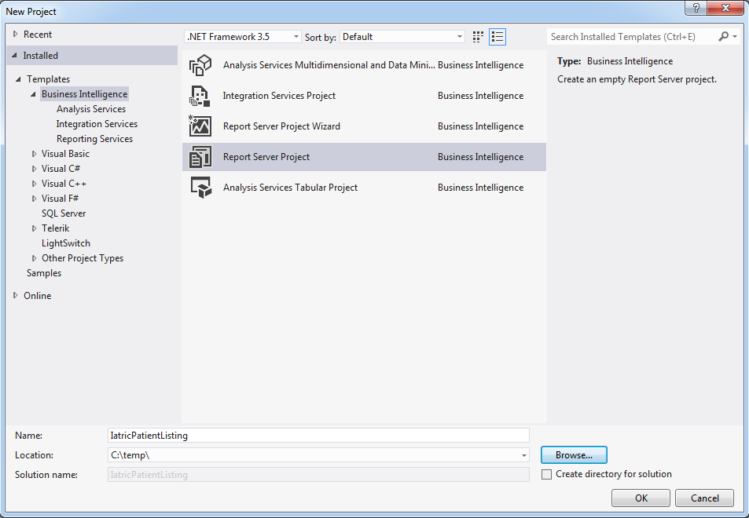
SQL Server Reporting Services Report Create Initial Project
From within SQL Server Data Tools, select File > New Project. Make sure to select Report Server Project, enter a name, and select a location to store the report project.

Slide 13
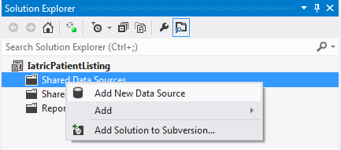
SQL Server Reporting Services Report Create Shared Data Source
Initially, a Data Source will need to be created that holds the connection information to the database. A best practice for this is to create a Shared Data Source so that all the reports use the same data source on the SSRS Server. The Shared Data Source will also help with the maintenance of the system.
In the Solution Explorer side bar on the right, right-click on Shared Data Sources and select New Data Source.

Slide 14
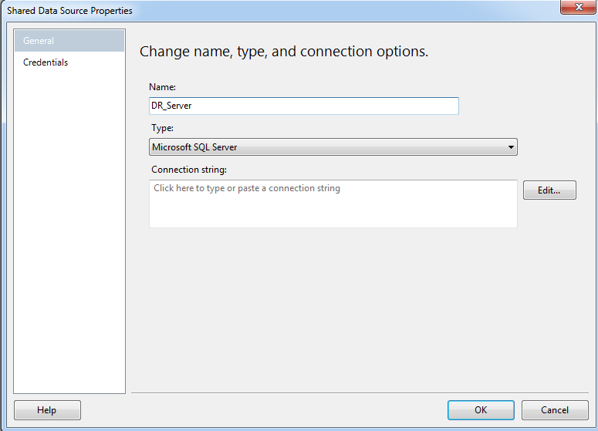
SQL Server Reporting Services Report Create Shared Data Source
Once the New Data Source option is selected, enter the name. Make sure this is the same name as the data source on the server.
Press the Edit button for the connection string. This will open the connection properties window.

Slide 15
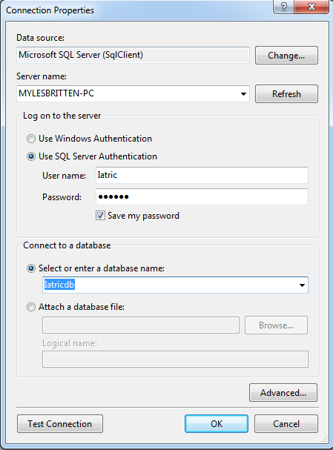
SQL Server Reporting Services Report Create Shared Data Source
On the Connection Properties window
Enter the SQL Server’s IP Address, Name, or URL.
Select authentication type and enter user name, password, and check option to save password if required
Select the database the data source will be using

Slide 16
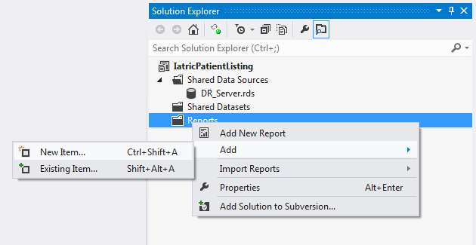
SQL Server Reporting Services Report Create Report
The next step in the process is to create a report. In the Solution Explorer side bar on the right, right-click on Reports and select Add and New Item. This will open the Add New Item window.

Slide 17
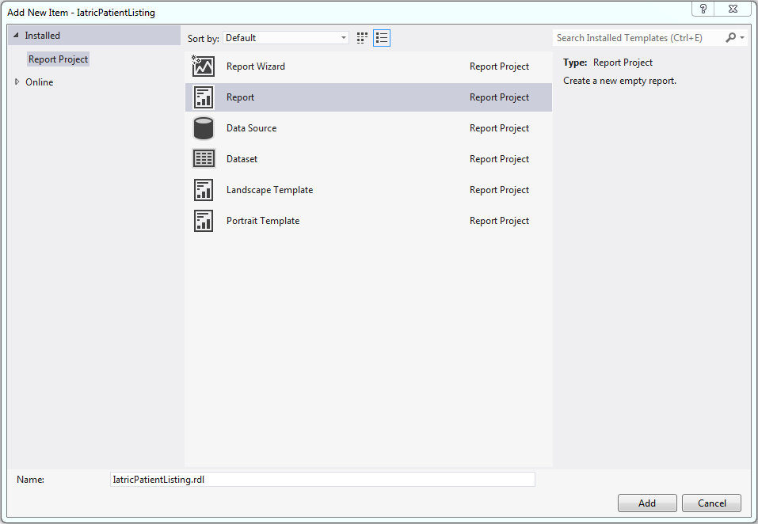
SQL Server Reporting Services Report Create Report
On the Add New Item window, select Report and enter a name for the report and press the Add button. The name that is entered will be the name of the RDL file that is uploaded to the Report Manager.

Slide 18
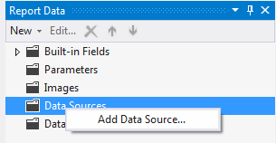
SQL Server Reporting Services Report Point Report to Shared Data Source
Now that the report file has been created, the first step is to configure a Data Source for the report.
In the Report Data sidebar, right-click on Data Sources and select Add Data Source.

Slide 19
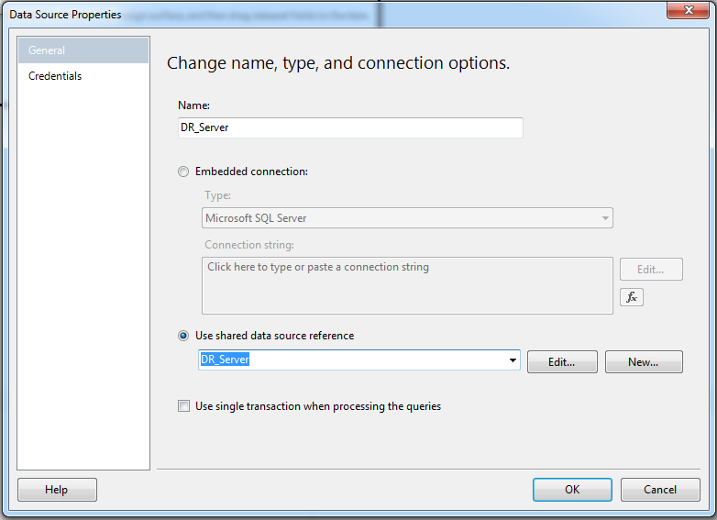
SQL Server Reporting Services Report Point Report to Shared Data Source
In the properties window
Assign the Data Source name to match the Shared Data Source create earlier.
Select Use shared data source reference
Select the shared data source that was created earlier from the drop down list
Select OK

Slide 20
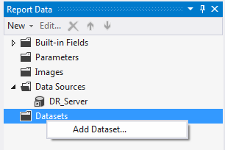
SQL Server Reporting Services Report Create Dataset(s)
In the Report Data sidebar, right-click on Datasets and select Add Dataset.

Slide 21
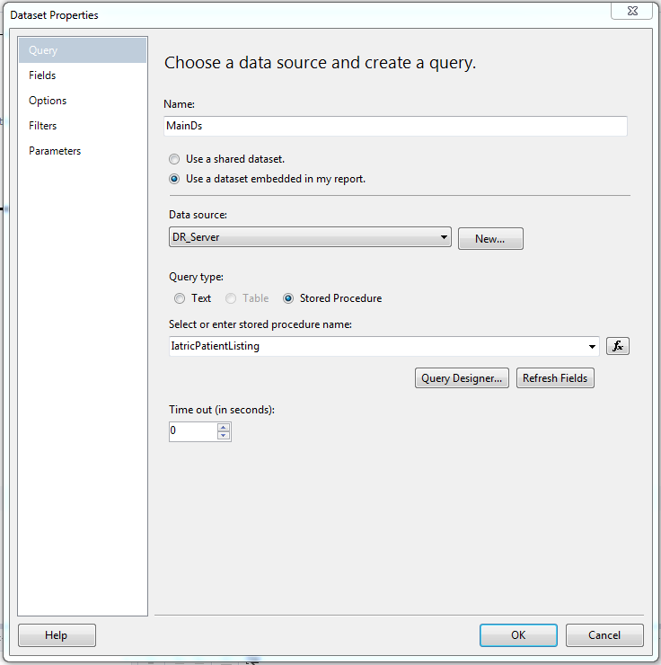
SQL Server Reporting Services Report Create Dataset(s)
In the Dataset Properties window
Enter a descriptive name for the dataset
Select Use a dataset embedded in my report
From the Data Source drop down list, select the Data Source that was created earlier
Select Stored Procedure as the Query Type
From the drop down list, select the Stored Procedure that contains the data for reporting
Select OK

Slide 22
SQL Server Reporting Services Report Report Items
Data region – renders data from an underlying dataset
Independent items – adds information and formatting to a report that is often not data related
Data Region
List (Tablix) | Presents data arranged in a free-form fashion
Table (Tablix) | Presents data in a row-by-row format
Matrix (Tablix) | Also know as a crosstab, contains both columns and rows that expand to accommodate data
Chart | Presents data graphically
Gauge | Displays an indicator within a range of values
Independent Items
Line | Horizontal, vertical, and diagonal lines can be added to a report to provide emphasis or separation of data
Textbox | Allows for entry of additional information
Image | Allow for an image to be placed on reports
Rectangles | Like lines, can be added to provide emphasis to data and can also contain other report items
Subreports | Are additional reports that are included on a report to offer supporting data
Notes:
Data Regions: http://technet.microsoft.com/en-us/library/ms157134(v=sql.100).aspx

Slide 23
SQL Server Reporting Services Report Common Aggregate Functions
Aggregate Functions
Avg | Average of non-null values
Count | Count of values
CountDistinct | Count of all distinct values
CountRows | Count of rows within the specified scope
First | First value
Min | Minimum non-null vale
RunningValue | Running aggregate (specify function)
StDev | Standard deviation of non-null values

Slide 24
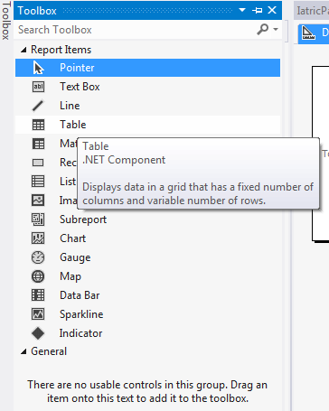
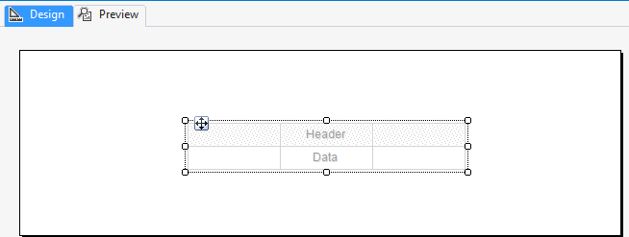
SQL Server Reporting Services Report Table Data Region
In the Toolbox window on the right, select Table and place on the report design area.

Slide 25
SQL Server Reporting Services Report Table Data Region
Start populating the table with appropriate fields by dragging the data columns from the dataset to the table.

Slide 26
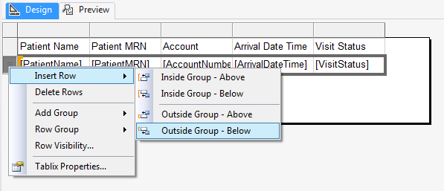
SQL Server Reporting Services Report Use Aggregate
Add an aggregate and label to the Table footer listing the count of patients.
Create Table footer if it doesn’t exist
Right-click on the detail row
Select Insert Row
Select Outside Group - Below

Slide 27
SQL Server Reporting Services Report Use Aggregate
Create the label by selecting a cell and directly typing the description for the label.
Note: The table control has some of the same capabilities as Excel, so you have the option to merge and split cells.

Slide 28
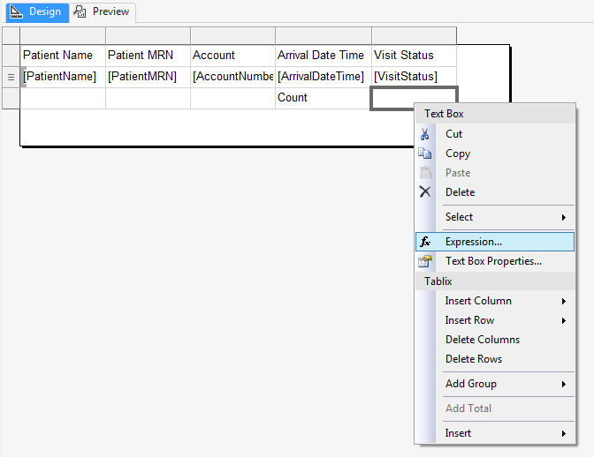
SQL Server Reporting Services Report Use Aggregate
To place the aggregate next to the label field that was previously created, an expression will need to be used.
Right-click on the field and select Expression.

Slide 29
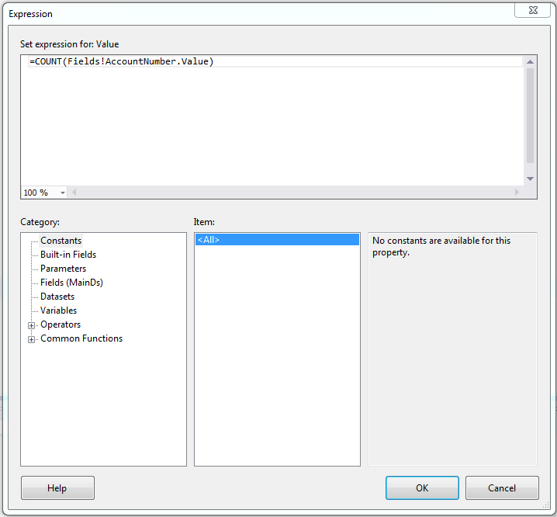
SQL Server Reporting Services Report Use Aggregate
In the Expression window, enter the aggregate expression to count the number of patients using the field AccountNumber and press OK.

Slide 30
SQL Server Reporting Services Report Preview Report
Now that we have some data configured on the report; select the Preview tab and run the report.
Note: The underlying stored procedure contains parameters, so they will need to be manually entered. The parameter section will be addressed at a latter point.

Slide 31
SQL Server Reporting Services Report Groups
A Group is a named set of data from the report dataset that is bound to a data region. Basically, a group organizes a view of the report’s dataset. All groups in a data region specify different views of the same report dataset.
There are two types of groups
Row
Column
A Group has a set of group expressions that are specified. This set of group expressions can be a single field reference from a dataset or a combination of multiple expressions.
After a group is created, data region-specific properties can be set, such as filter and sort expressions, page breaks, and group variables to hold scope-specific data.
Notes:
Understanding Groups (Report Builder and SSRS): http://technet.microsoft.com/en-us/library/dd255263.aspx

Slide 32
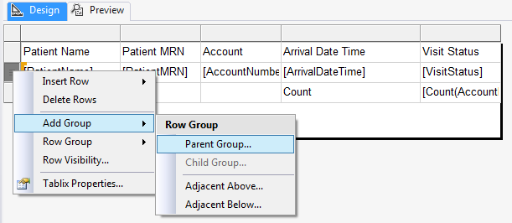
SQL Server Reporting Services Report Row Group
Add grouping to the Table based on the VisitStatus column.
Right-click on the detail row (marked with three lines) and select Add Group and then Parent Group.

Slide 33
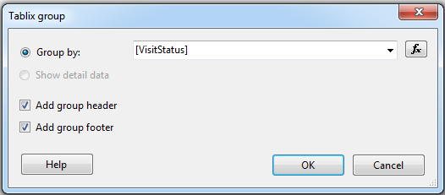
SQL Server Reporting Services Report Row Group
In the Tablix group window, select VisitStatus from the drop down list, check the boxes for Add group header and Add group footer, and select OK.

Slide 34
SQL Server Reporting Services Report Row Group
Cleanup the report
Remove newly created Visit Status column
Merge the cells in the group header
Place the value of the VisitStatus in the group header
Move the aggregate and label to allow for removal of Visit Status column
Remove the Visit Status column
Place a label in the group footer for patient count per status
Place aggregate in group footer for patient count per status

Slide 35
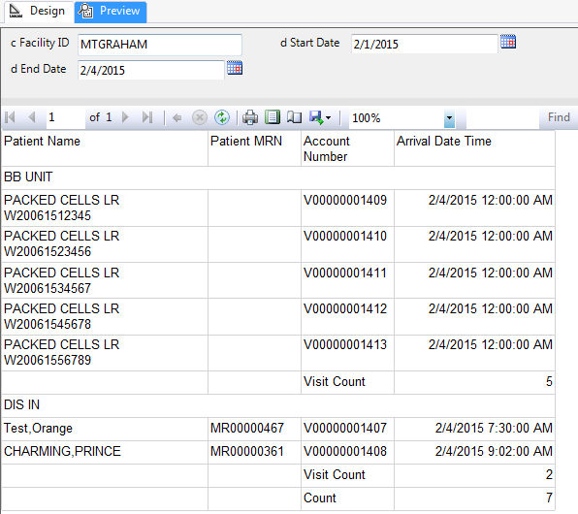
SQL Server Reporting Services Report Row Group - Preview Report
Now that we have the grouping configured and the report cleaned up; select the Preview tab and run the report.

Slide 36
SQL Server Reporting Services Report Row Group (Detail Sorting)
Sorting/Filter within a Table is in multiple places, but be cautious where it is placed when groups are involved. When the VisitStatus group was created, the VisitStatus column was automatically added to the sorting for the group at the top level.
Add additional sorting by PatientName to the detail group by using the drop down list for the VisitStatus from the Row Groups window and selecting Group Properties.

Slide 37
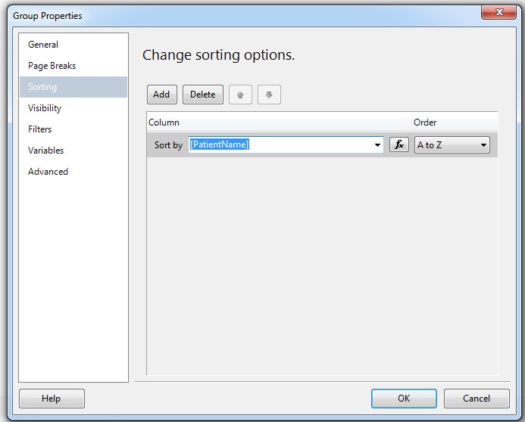
SQL Server Reporting Services Report Row Group (Detail Sorting)
On the Group Properties window
Select Sorting from the left pane
Select the Add button to insert an additional sorting expression
From the drop down list select PatientName
Accept the default Order A to Z
Select OK

Slide 38
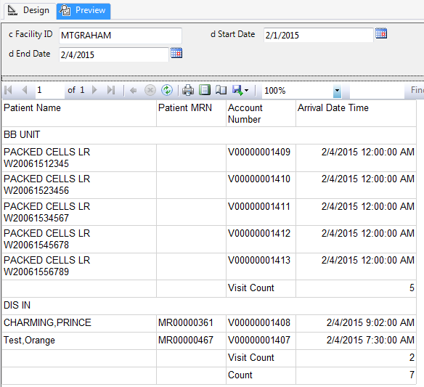
SQL Server Reporting Services Report Row Group (Detail Sorting) – Preview Report
Now that we have added the additional sorting of the patient’s name; select the Preview tab and run the report.

Slide 39
SQL Server Reporting Services Report Column Group
To take a look at column grouping, we will need to create a new project and report.
Note: An additional report can be added to the project. However, as a best practice we suggest separating your reports into individual projects.
Name the project IatricColumnGroups
Create Shared Data Source
Create report with the name IatricColumnGroups
Create Data Source pointing to Shared Data Source
Create dataset for report pointing to the stored procedure IatricColumnGroups (the stored procedure returns a listing of cities and patient arrival hours based on a date range)

Slide 40
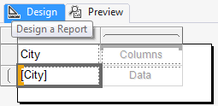
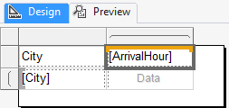
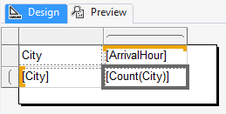
SQL Server Reporting Services Report Column Group
Time to start placing information on the report canvas. By following the steps below, the report will list the cities and the number of patients that arrived at the facility per hour with the hours listed in columns.
Place a Matrix from the toolbox on the report canvas
Place the column City in the first column of the Matrix
Place the column ArrivalHour into the column grouping header
Place a count of the City in the field directly below the ArrivalHour

Slide 41
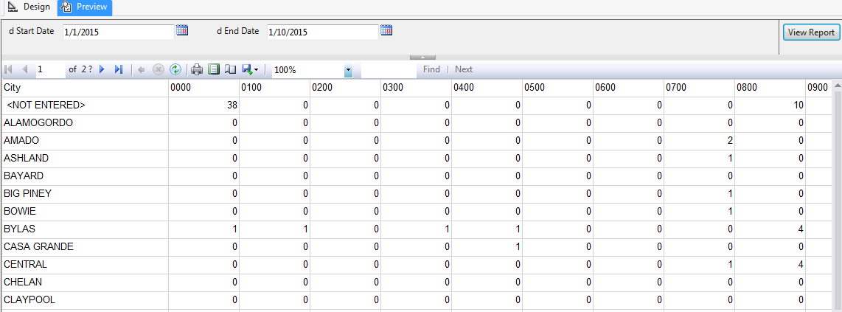
SQL Server Reporting Services Report Column Group - Preview Report
Now that we have the grouping configured; select the Preview tab and run the report.

Slide 42
SQL Server Reporting Services Report Conditional Formatting
When formatting a report, it is sometimes useful to base the formatting on the data that is being displayed
Common Uses
Make negative numbers red and positive black
Alternating row color (similar to green and blue bar paper)
Hiding a row based on a value in the row
Example expression for alternating row color between WhiteSmoke and NoColor
Example expression for hiding a row if the DischargeDateTime is NULL
Note: Notice that in the code above that text is placed within double quotes versus single quotes like in SQL.
Notes:
Conditional Formatting: http://technet.microsoft.com/en-us/library/ms156400(v=sql.100).aspx

Slide 43
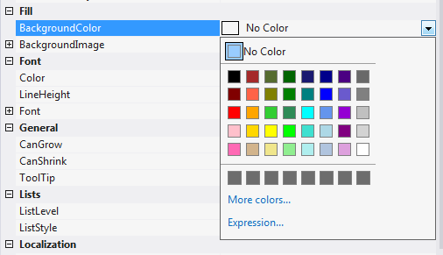
SQL Server Reporting Services Report Conditional Formatting
Add alternating row color to the detail line of the IatricPatientListing report.
Select the detail row of the table which allows you to set properties for the entire row
In the property window, select the BackgroundColor property
Select the drop down on the right hand side of the property to expand the options
Select Expression at the bottom of the drop down window

Slide 44
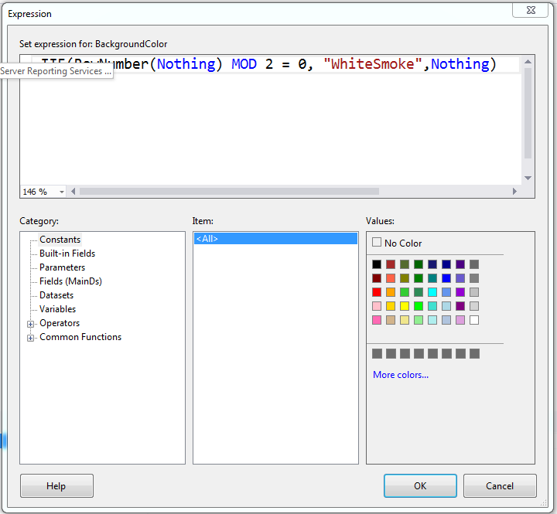
SQL Server Reporting Services Report Conditional Formatting
Add alternating row color to the detail line of the IatricPatientListing report (continued).
In the Expression windows, opened from the previous selection, type in the statement that will alternate the color between WhiteSmoke and NoColor and select OK

Slide 45
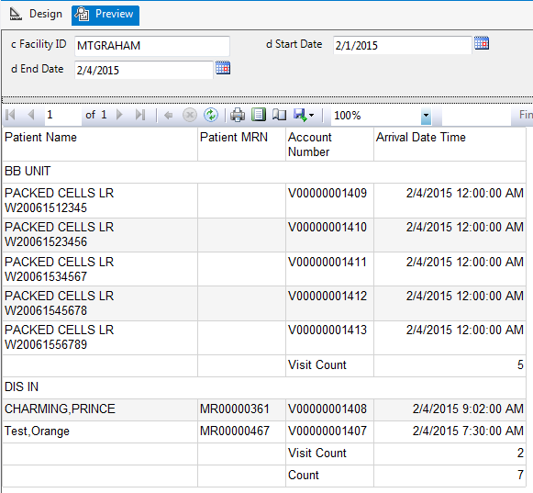
SQL Server Reporting Services Report Conditional Formatting - Preview Report
Now that we have alternating row color configured; select the Preview tab and run the report.

Slide 46
SQL Server Reporting Services Report Conditional Formatting
Add conditional formatting to the font color of a column of the IatricPatientListing report.
Add the column AbstractID to the table
Select the AbstractID field and place conditional formatting on the Font Color property (Red when value is 800 else black)
In the property window, select the Color property under Font
Select the drop down on the right hand side of the property to expand the options
Select Expression at the bottom of the drop down window
Enter the code below and select OK

Slide 47
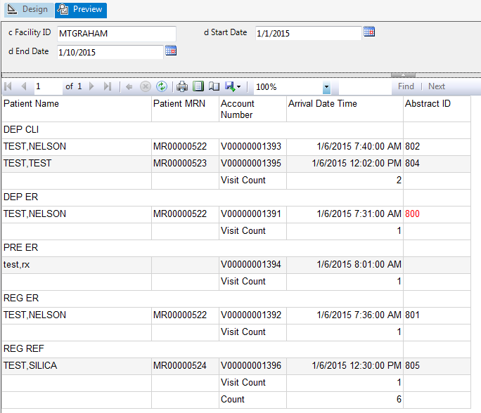
SQL Server Reporting Services Report Conditional Formatting - Preview Report
Now that we have conditional formatting on a font color configured; select the Preview tab and run the report.

Slide 48
SQL Server Reporting Services Report Conditional Formatting
Add conditional formatting to the visibility of a column of the IatricPatientListing report.
Select the PatientName field and place conditional formatting on the Hidden property (True if blank and False if value exists)
In the property window, select the Hidden property
Select the drop down on the right hand side of the property to expand the options
Select Expression at the bottom of the drop down window
Enter the code below and select OK

Slide 49
SQL Server Reporting Services Report Conditional Formatting - Preview Report
Now that we have conditional formatting on a Hidden property configured; select the Preview tab and run the report.

Slide 50
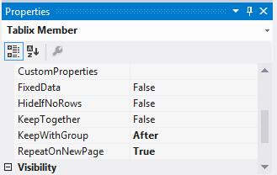
SQL Server Reporting Services Report Repeating Group Headers
As soon as a Table, List, or Matrix is created with group headers, you will find that the header will only appear on the first page. However, the good news is that this can be corrected.
Select Advanced Mode from the drop down arrow that is found in the lower right of the Design Pane next to the Column Groups
Once the Advanced Mode option has been selected, additional information will be displayed under the Row and Column Groups. Highlight the (Static) field that appears under the Row Groups
In the Properties window on the right, set KeepWithGroup to After and RepeatOnNewPage to True
Notes:
Repeating Tablix Headers: http://bignickolson.com/2009/03/11/repeating-tablix-headers-in-ssrs-2008/

Slide 51
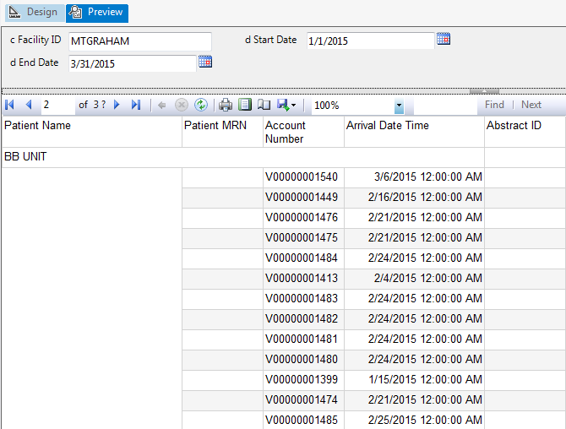
SQL Server Reporting Services Report Repeating Group Headers - Preview Report
Now that we have repeating group headers configured; select the Preview tab and run the report.

Slide 52
SQL Server Reporting Services Report Parameters
In a report, parameters can be used to
Filter data
Internally set in report
User selection at runtime
Vary appearance
Internally set in report
User selection at runtime
Connect to related reports
Pass data to an external report
Pass data to an internal report (subreport)
Expressions that are used within the report can refer to these parameters to either modify data or the appearance of the report.
Note: Be cautious when creating cascading parameters. The order of the parameters are important. Make sure that a referenced parameter is defined higher in the list if another parameter will be consuming it.

Slide 53
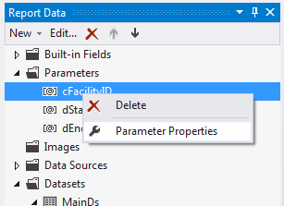
SQL Server Reporting Services Report Parameters
As seen in the previous slides, the IatricPatientListing report requires three parameters (Facility, Start Date, and End Date). To address these parameters some additional setup is required.
Create a New Dataset for the facility named FacilityDs using the stored procedure IatricFacilityList
In the Report Data Window
Expand the Parameters
Right-click the cFacilityID parameter and select Parameter Properties
Notes:
USE [Iatricdb]
GO
SET ANSI_NULLS ON
GO
SET QUOTED_IDENTIFIER ON
GO
CREATE PROCEDURE [dbo].[IatricFacilityList]
AS
/*********************************************************************************************************
* _____ _ _ _____ _
* |_ _| | | (_) / ____| | |
* | | __ _| |_ _ __ _ ___ | (___ _ _ ___| |_ ___ _ __ ___ ___
* | | / _` | __| '__| |/ __| \___ \| | | / __| __/ _ \ '_ ` _ \/ __|
* _| || (_| | |_| | | | (__ ____) | |_| \__ \ || __/ | | | | \__ \
* |_____\__,_|\__|_| |_|\___| |_____/ \__, |___/\__\___|_| |_| |_|___/
* __/ |
* |___/
* 27 Great Pond Dr, Boxford MA, 01921
* info@iatric.com 978-805-4100
* Copyright © 2014 Iatric Systems Inc. All Rights Reserved
*
* Author: Myles Britten
* Create Date: February 20, 2014
* Description: Retrieves Listing of Facilities
**********************************************************************************************************/
BEGIN
SET NOCOUNT ON ;
SELECT FacilityID
,Name
FROM Livendb.dbo.DMisFacilities
WHERE Active = 'Y'
ORDER BY Name
END;

Slide 54
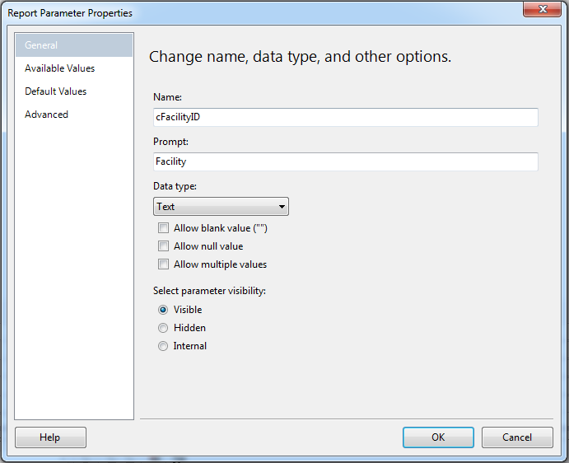
SQL Server Reporting Services Report Parameters
Continued …
On the General tab in the Report Parameter Properties window, update the Prompt property with the description to be displayed on the parameter selection area on the report

Slide 55
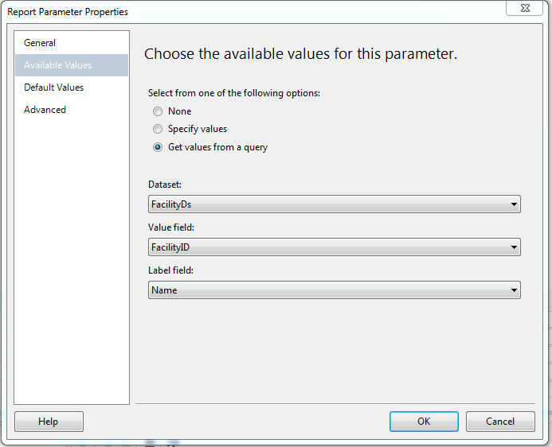
SQL Server Reporting Services Report Parameters
Continued …
On the Available Values tab in the Report Parameter Properties window
Select Get values from a query
Select the FacilityDs for the Dataset option
Select FacilityID for the Value field option
Select Name for the Label field option

Slide 56
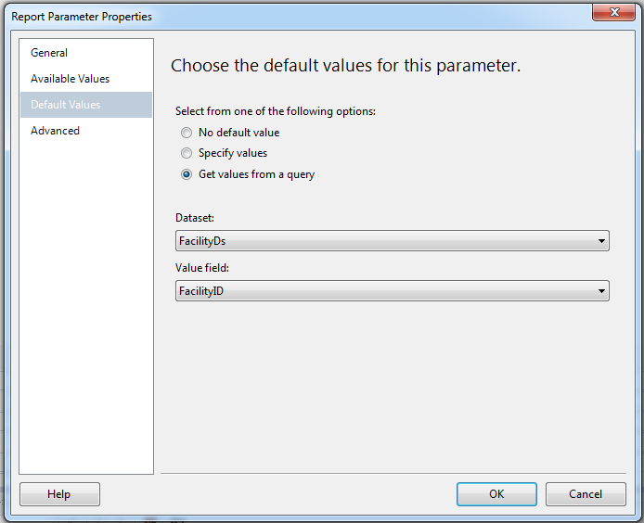
SQL Server Reporting Services Report Parameters
Continued …
On the Default Values tab in the Report Parameter Properties window (to default to the first value)
Select Get values from a query
Select the FacilityDs for the Dataset option
Select FacilityID for the Value field option

Slide 57
SQL Server Reporting Services Report Parameters
Continued …
Update the date parameters Prompt property with the description to be displayed on the parameter selection area on the report
Now that we have the parameters configured; select the Preview tab to verify the parameter changes.

Slide 58
SQL Server Reporting Services Report Custom Code
Custom Code can be provided in two ways
Embed code written in Visual Basic directly in your report. If the code refers to a Microsoft .NET framework that is not System.Math or System.Convert, you must add the reference to the report.
Provide a custom code assembly by using the .NET Framework. If you provide a custom assembly, you must install it on both the computer where you author the report and the report server where you view the report.

Slide 59
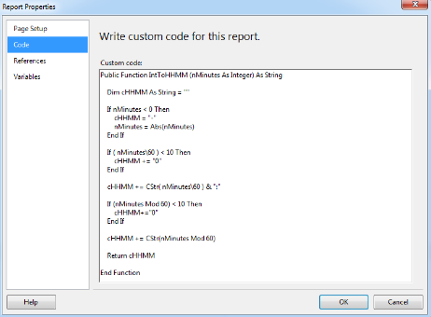
SQL Server Reporting Services Report Custom Code (Embed Code)
The IatricPateintListing code includes a column for Length of Stay (LOS). However, the value is returned in minutes and the report requires the display to be in the format of hours and minutes (HH:MM). This could be accomplished with a complicated expression, but is simplified by entering VB code in the Custom Code window.
To add the VB Code in the report …
Open the Report Properties, by selecting Report and Report Properties
On the left side of the properties window, select Code
Enter the VB Code into the Custom Code window and select OK
Notes:
Public Function IntToHHMM (nMinutes As Integer) As String
Dim cHHMM As String
If nMinutes < 0 Then
nMinutes = 0
End If
If ( nMinutes\60 ) < 10 Then
cHHMM = "0"+( CStr( nMinutes\60 ) )
Else
cHHMM = CStr( nMinutes\60 )
End If
cHHMM = cHHMM + ":"
If (nMinutes Mod 60) < 10 Then
cHHMM = cHHMM + "0"+( CStr(nMinutes mod 60) )
Else
cHHMM = cHHMM + ( CStr(nMinutes mod 60) )
End If
Return cHHMM
End Function

Slide 60
SQL Server Reporting Services Report Custom Code (Embed Code)
Now that the VB Code has been stored in the report properties, it can be referenced within any expression.
Add the LOS column to report (remove the default SUM in the Group Footer)
Select the LOS column field on the report
Right-click on the field and select Expression
In the Expression window, reference the code and select OK
Code – Points to the VB Code in the report properties
IntToHHMM - Name of the VB function to call within the report properties
Fields!LOS.Value – Parameter being passed to VB function

Slide 61
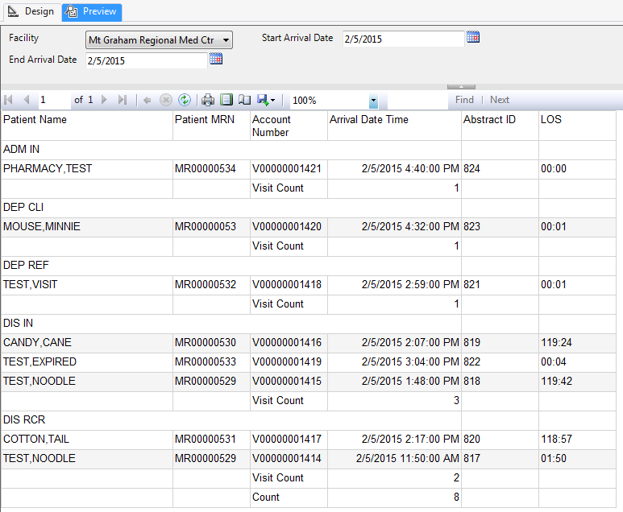
SQL Server Reporting Services Report Custom Code (Embed Code) - Preview Report
Now that we have the custom code configured; select the Preview tab and run the report.

Slide 62
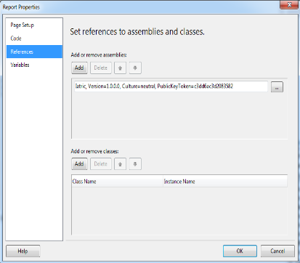
SQL Server Reporting Services Report Custom Code (Code Assembly)
To use a Custom Code Assembly, a few additional steps are required. Initially a Visual Basic DLL needs to be created with the custom coding required within the report.
To reference the DLL within the report …
Open the Report Properties, by selecting Report and Report Properties
On the left side of the properties window, select References
Select the DLL from the storage location on the local machine
Notes:
For Visual Studio 2012, assuming default locations were chosen during install, the DLL will need to be place in the following locations to make sure you will be able to Preview your report.
C:\Program Files (x86)\Microsoft Visual Studio 11.0\Common7\IDE\PrivateAssemblies
C:\Windows\assembly

Slide 63
SQL Server Reporting Services Report Custom Code (Code Assembly)
Now that a reference has been created to the Visual Basic DLL, it can be referenced within any expression.
Select the column field on the report that the specialized formatting applies
Right-click on the field and select Expression
In the Expression window, reference the code and select OK
Iatric – Points to the referenced DLL
SSRS – Points to the Class within the DLL
MinutesToHHMM - Name of the VB function to call within the DLL Class
Fields!LOS.Value – Parameter being passed to the function

Slide 64
SQL Server Reporting Services Report Stylized Reports (Custom Style Table)
To Create Stylized Reports …
Create a table with required columns in a custom database (below example is per Facility Identifier)
Populate the table with style values
Column | Description
FacilityID | Facility Identifier
StyleID | Style Identifier
Name | Description of the Style
Value | Value for the Style

Slide 65
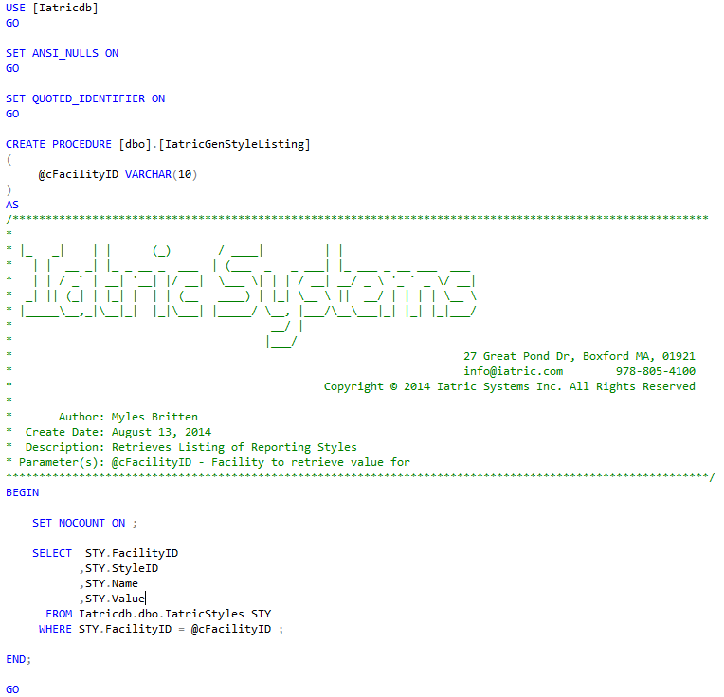
SQL Server Reporting Services Report Stylized Reports (Stored Procedure)
To retrieve the values that are placed in the custom table, a stored procedure will need to be created that will return all the styles based on the Facility Identifier.

Slide 66
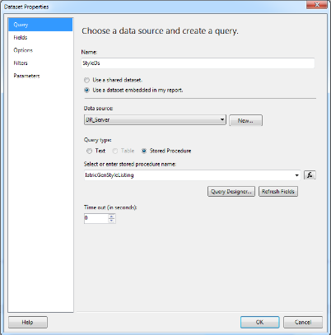
SQL Server Reporting Services Report Stylized Reports (Dataset)
To use the values for the styles in the report, a dataset StyleDs will need to be created using the stored procedure that was previously created (IatricGenStyleListing). Create this dataset in the IatricPatientListing report.

Slide 67
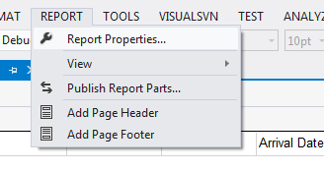
SQL Server Reporting Services Report Stylized Reports (Variables)
Variables will need to be created at the report level to hold the value of the styles.
Create these variables in the IatricPatientListing report.
Open the Report Properties window by selecting Report and Report Properties.

Slide 68
SQL Server Reporting Services Report Stylized Reports (Variables)
In the Report Properties window
Select the Variables tab
Select the Add button to create new variable
Enter the descriptive name for the variable
Select the fx button
In the expression window, enter code to retrieve value from the style dataset created previously
Repeat until all required variables have been added
Notes:
Lookup Function: https://msdn.microsoft.com/en-us/library/ee210531.aspx

Slide 69
SQL Server Reporting Services Report Stylized Reports (Assigning Variables)
With the stylized data placed in the report variables, the report items may now reference this information.
Within the IatricPatientListing report ..
Modify the Background color of the report header to use the variable Header1BackColor
Modify the font color of the report header to use the variable Header1Color
Modify the Background color of the VisitStatus group header to use the variable Header2BackColor
Modify the font color of the VisitStatus group header to use the variable Header2Color

Slide 70
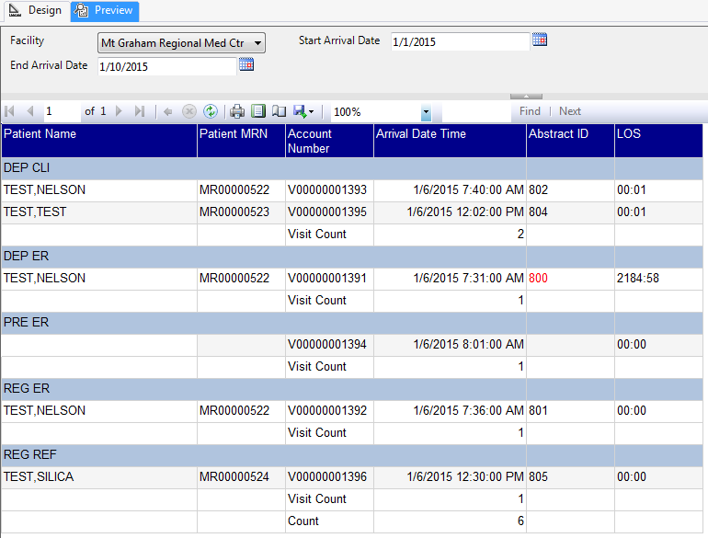
SQL Server Reporting Services Report Stylized Reports – Preview Report
Now that we have the stylized options configured; select the Preview tab and run the report.

Slide 71
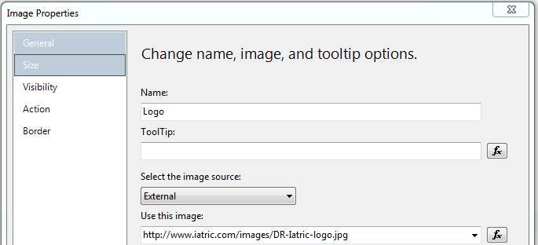
SQL Server Reporting Services Report Stylized Reports (Logo)
Within most Facilities, marketing tends to modify the logo from time to time. This modification can require a massive change to the reports unless the logo is not embedded within the report. This can be accomplished by setting the image object for the logo to reference a URL.
Add logo to IatricPatientListing report ..
Add a page header to the report
Right-click on the design surface (not report)
Select Add Page Header
Place an image on the Report Header from the Toolbox
Within the Image Properties window
Enter a name for the Logo image
Select External for image source
Enter the URL for “Use this image”

Slide 72
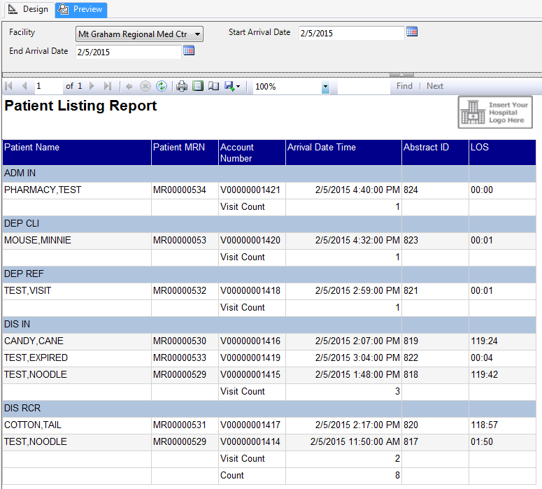
SQL Server Reporting Services Report Stylized Reports – Preview Report
Now that we have the logo configured; select the Preview tab and run the report.

Slide 73
Questions

