Slide 1
Meditech Data Repository: What is it, and how do I use it? Part 1 (SQL)
Presented By:
Myles Britten
5/26/2015

Slide 2
Introduction
Myles Britten
DR Programmer/Analyst with Iatric Systems Reporting Services
Seven + years of Meditech DR SQL experience
Sixteen years hospital IT experience
Fifteen years of business/one + years clinical reporting experience with Home Grown (AS/400), Lawson, and Meditech at hospital

Slide 3
Covered topics
During this training session, the following topics will be covered
Overview of what the DR actually is
Overview of SQL Server Management Studio
Overview of SQL Object Types
Walkthrough of the Core SQL commands
Create Functions
Create Stored Procedures
Demonstrate the methods of how to find data in the DR based on NPR location
Overview of some Best Practices along the way

Slide 4
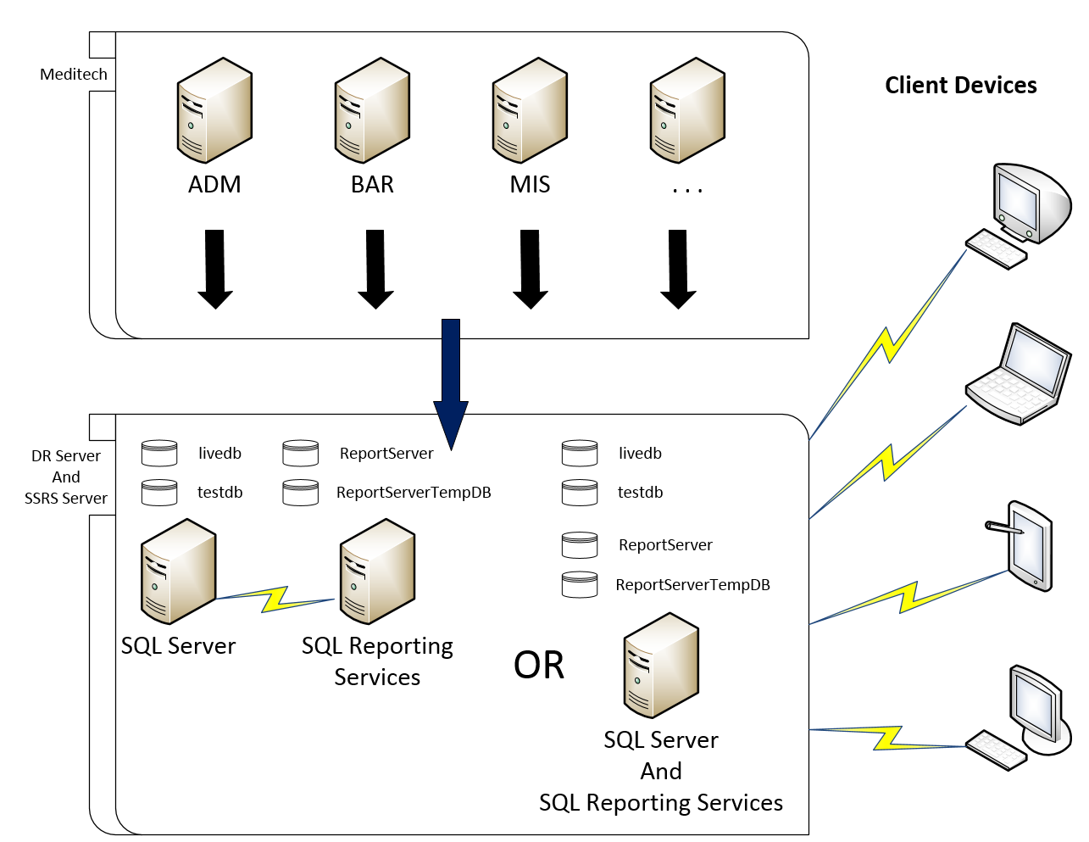
DR Overview Diagram

Slide 5
DR Overview DR XFER Process
The DR XFER process sends data from the Meditech system to the Data Repository.
Each Meditech server has activity logs. These records are continuously updated when a new record is created, modified or deleted in the Meditech system.
Activity logs are monitored for changes by a service running on each server. The process creates an equivalent SQL statement for each transaction and sends the data to the Data Repository.
Each application has its own queue and all transactions are sent down the same pipe line to the DR.
Notes:
The DR xfer process: http://www.meditech.com/prdr/Pages/DRxbASTransferMechanism.htm

Slide 6
DR Overview DR XFER Process
There are two types of transfer modes.
Batch Mode is typically run once per day and sends the previous days transactions to the DR Server. This can leave the DR out of sync by over 24 hours.
Continuous Mode continuously streams transactions to the DR Server. This is the most common of the two. Delays can be as little as a couple of minutes but not usually more than 15 minutes.
Although infrequent, two types of errors can occur for the continuous mode. Non-fatal and fatal. A non-fatal error will prevent a record from crossing over to the DR and a fatal error will crash the transfer process.
If you notice that there is missing data or it appears that nothing has come across for some time, open a Meditech support ticket to send the missing record or restart the transfer process.

Slide 7
SQL Server Management Studio Overview Base Information
SQL Server Management Studio is an integrated environment for managing your SQL Server infrastructure. Management Studio provides tools to configure, monitor, and administer instances of SQL Server. It also provides tools to deploy, monitor, and upgrade the data-tier components, such as databases and data warehouses used by your applications, and to build queries and scripts.
Some common functions:
Browse database objects in a tree like structure, by expanding and collapsing headings
Write ad hoc queries to view the data in the tables
Create various objects such as stored procedures, views, custom tables, functions, indexes, etc.
View the execution plan of a query to show efficiencies and where improvements may be made
Create new records, modify records and delete records
** This should never be done in the Meditech database

Slide 8
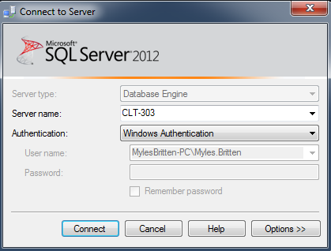
SQL Server Management Studio Overview Connection to Database
Server name:
Enter the IP address, URL or name of the SQL Server.
Authentication:
Windows Authentication
Uses the current AD account to gain access to the SQL Server. The username and password will automatically be passed in the background.
SQL Server Authentication
Accounts are managed and exist only in the SQL Server. The username and password will need to be manually entered for this authentication type.

Slide 9
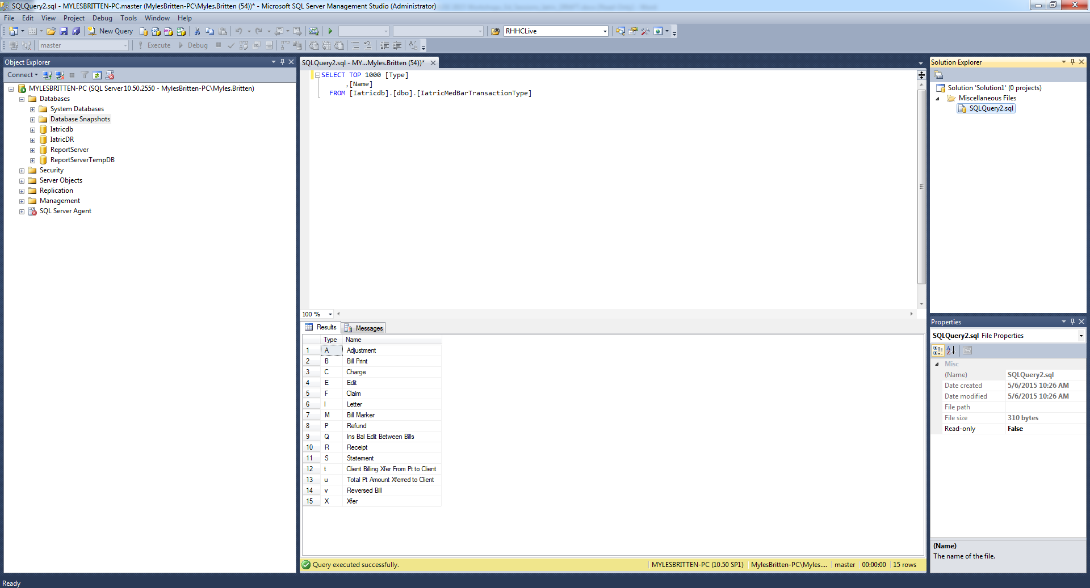
SQL Server Management Studio Overview Interface Layout
2
4
1
3
5
Object Explorer – Provides features for managing objects in instances of the Database Engine, Analysis Services, Integration Services, and Reporting Services.
Query Window – Area to create, modify, and execute queries.
Results/Messages – Area to display the results and messages from executed queries. Execution plan results will also be displayed in this area.
Solution Explorer – Displays the Project and any SQL files that are currently open.
Properties Window – Displays the properties of the highlighted object.

Slide 10
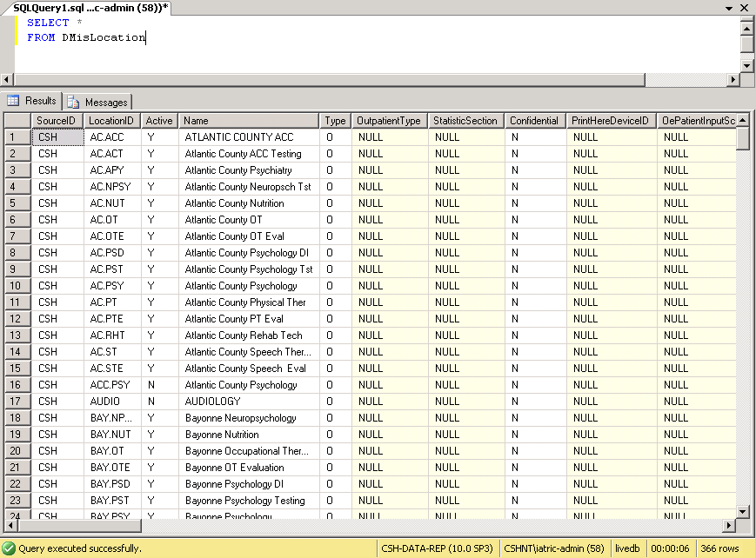
SQL Object Types Table
Tables are used to house data that is stored as rows of column data.
The example below is displaying a listing of the records (rows) from the MIS Location dictionary table.

Slide 11
SQL Object Types View
A view can be thought of as either a virtual table or stored query. The data accessible through a view is not stored in the database as a distinct object. Instead, it is stored in the database as a SELECT statement. The result set of the SELECT statement forms the virtual table returned by the view. A user can use this virtual table by referencing the view name in SQL statements the same way a table is referenced.

Slide 12
SQL Object Types Functions
A function is a stored program that can be passed parameters and return a value.
Function Types
Table-valued
User defined function that returns a table variable as a result of the actions performed by the function.
Scalar-valued
User defined function that returns a single value as a result of the actions performed by the function.
Aggregate
System defined function that operates on a collection of values and returns a single value (ex. MAX(), MIN(), …).
System
System defined function that operates on a single value and returns a single value (ex. UPPER(), LTRIM(), …).

Slide 13
SQL Object Types Stored Procedures
A stored procedure is a group of SQL statements compiled into a single execution plan.
Returns data in four ways
Output parameters, which can return wither data (such as an integer or character value) or a cursor variable (cursors are result sets that can be retrieved one row at a time).
Return codes, which are always an integer value
A result set for each SELECT statement contained in the stored procedure or any other stored procedures called by the stored procedure.
A global cursor that can be referenced outside the stored procedure.

Slide 14
Meditech Table Types Review in SSMS
Within the Meditech DR system, there are three types of tables.
Single-entry: Tables that have a single entry per patient.
Livendb.dbo.AdmVisits
Livendb.dbo.AdmDischarge
Livendb.dbo.AdmittingData
Livendb.dbo.AdmVitalSigns
Livendb.dbo.AdmProviders
Multiple-entry: Tables that have one to many entries per patient.
Livendb.dbo.AdmInsuranceOrder
Livendb.dbo.AbsDrgDiagnoses
Dictionary: Tables that are similar to the single-entry tables, but hold system configuration information.
Livendb.dbo.DMisProvider
Livendb.dbo.DMisUsers

Slide 15
Core SQL Commands Comments
Comments are vital to maintenance.
Single line comment:
Multi-line comment:
Best practice tips
Use single line style for all comments (except the header) to allow blocking out with multi-line style during testing and troubleshooting.
After highlighting a section use Ctrl+k+c to comment it out and Ctrl+k+u to uncomment it.
When writing a stored procedure or function, place the header block of comments after the AS statement. This will make sure that your comments are stored in the database with the code.

Slide 16
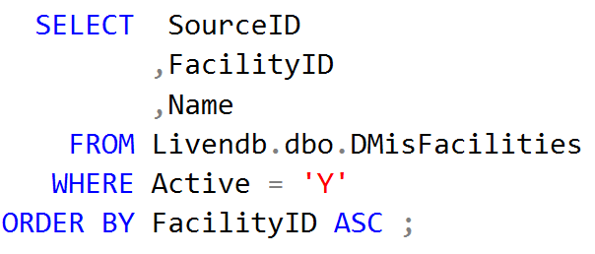
Core SQL Commands SELECT
The SELECT statement will retrieve data and return one or more result sets made up of columns and rows.
Breakdown of the command above
SELECT – Statement informing the code of an action to retrieve data.
SourceID, FacilityID, Name – Listing of columns to return ( * returns all fields).
FROM – Clause to specify the data source.
Livendb.dbo.DMisFacilities – Catalog.Owner.Table.
WHERE – Clause to specify filtering of data.
ORDER BY – Sequence in which the rows of the dataset are returned. (ASC) Ascending [default] (DESC) Descending.
; - Statement terminator.
Notes:
The SELECT command: http://msdn.microsoft.com/en-us/library/ms189499.aspx

Slide 17
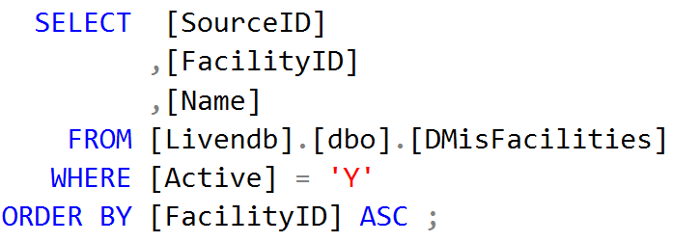
Core SQL Commands Brackets vs. No Brackets
Brackets are optional, except when they are not. It is a best practice to use the brackets if a database/table/column/etc. name is also a reserved keyword within SQL. Typically, SQL Server Management Studio will change the font color of these informing you that it is a reserved keyword. If there is a question, use the brackets.

Slide 18
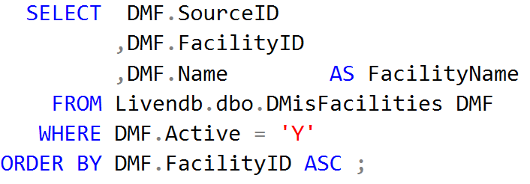
Core SQL Commands Aliasing
SQL has the ability to use shorthand notation called aliasing. This notation can be extremely helpful when writing SQL statements. Aliasing can be used on tables or columns.
In the code above two aliases where used. These options will become more useful with more complex SQL statements.
Table alias DMF
This allows for reference to the table without having to fully qualify the table name. This is extremely helpful when a table is required to be referenced more than once.
Column alias FacilityName
This allows the renaming of the column. This can be used to clarify the data that is contained in the column.

Slide 19
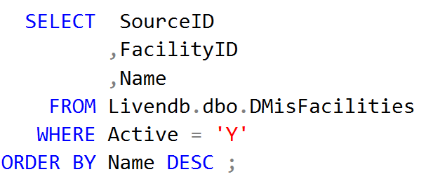
Core SQL Commands ORDER BY
This clause is used to order the result set by a specific column list. The order in which the result set is returned is not guaranteed unless the ORDER BY clause is specified. Ascending (ASC) or descending (DESC) can be specified. The default order is ascending if not specified.
Record set will be order by the column FacilityID in ascending order.
Record set will be order by the column Name in descending order.

Slide 20
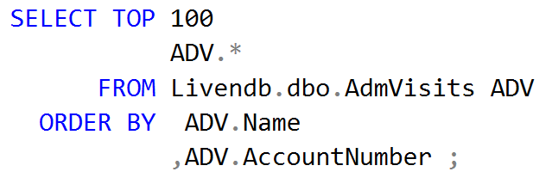
Core SQL Commands TOP
To retrieve only a select number of record sets, the TOP statement can be used. This statement will retrieve the first number of record sets. This statement is usually for testing only, but there are times when it will need to be used in production.

Slide 21
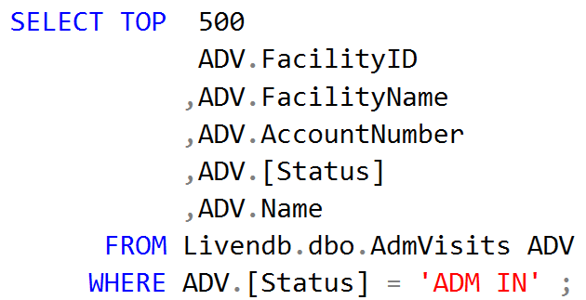
Core SQL Commands WHERE
The result set returned from a SQL statement can have a filter clause placed on it to restrict the data set that is returned. This is done by using comparison operators, string value comparisons, logical operators, range of values, and lists of values. The majority of the reporting that will be done at an organization will require filtering by using the WHERE clause.
Scalar Comparison Operators
= | Equal
<> or != | Not equal
> | Greater than
< | Less than
>= | Greater than or equal
<= | Less than or equal
Notes:
The WHERE clause of SELECT: http://msdn.microsoft.com/en-us/library/ms188047.aspx

Slide 22
Core SQL Commands WHERE
String Comparisons are used for types of text, ntext, char, nchar, varchar, and nvarchar. The string comparison has predicates for full or partial match comparisons.
String Comparison Operators
= |  | Values are the same
LIKE |  | Specific pattern with wildcards
 | % | Replaces any string of zero or more characters
 | _ | Replaces and single character
 | [a-c] | Replaces a single character within the range
 | [^a-c] | Replaces a single character not within the range
CONTAINS |  | Conducts a less precise match (will not cover)
FREETEXT |  | Less used option (will not cover)

Slide 23
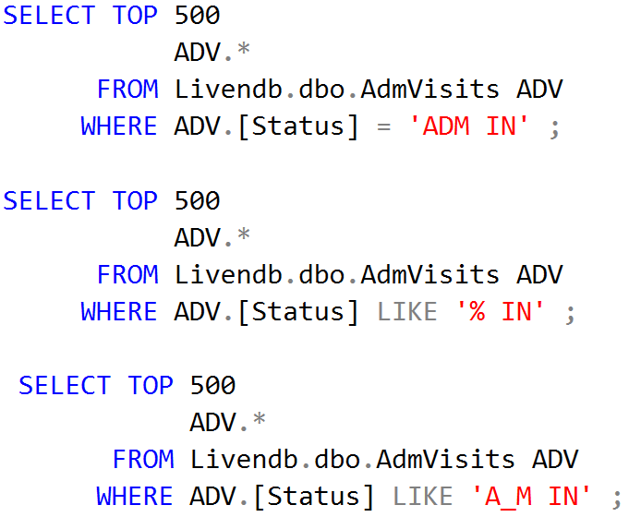
Core SQL Commands WHERE
String Comparison Operator Examples

Slide 24
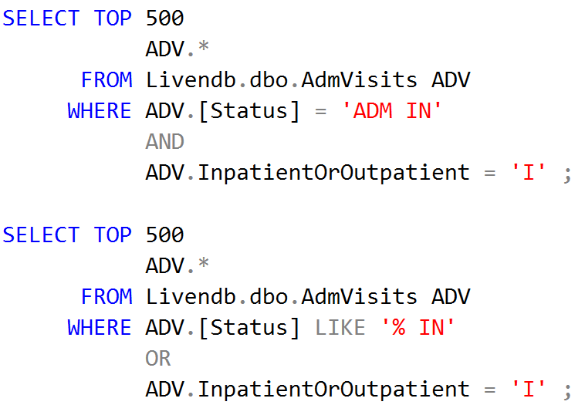
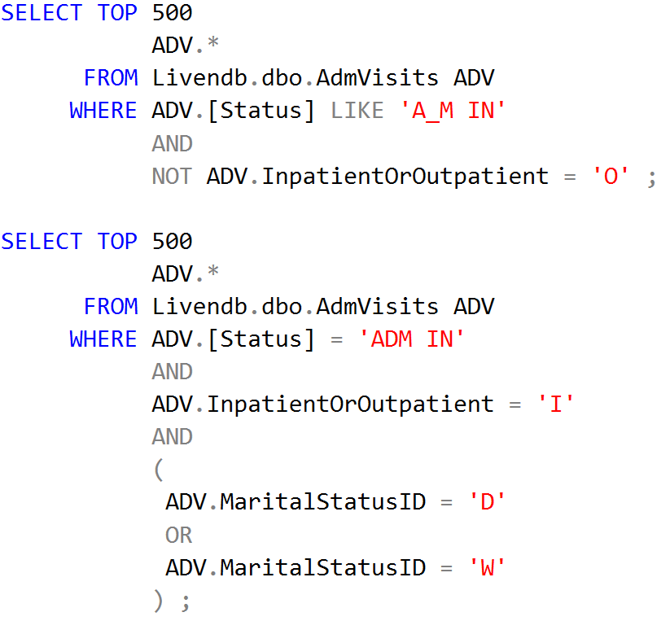
Core SQL Commands WHERE
Logical Operators are used to combine conditions in a statement
Logical Operators
AND | Both are required to be true
OR | One or both are required to be true
NOT | Reverses the comparison
Notes:
Summary of logical operators: http://msdn.microsoft.com/en-us/library/ms189773

Slide 25
Core SQL Commands WHERE
Frequently a range of values are required. This can be done by chaining values together with an operator using the BETWEEN predicate with a low and high value. The BETWEEN predicate is equivalent to using the equal and less than equal expression.
Other times a listing of values are required. This option can also be done by chaining values together with an operator or using the IN predicate with a list of values. The IN predicate is equivalent to using many expressions with OR between them.
Notes:
The IN operator in WHERE: http://msdn.microsoft.com/en-us/library/ms177682.aspx

Slide 26
Core SQL Commands WHERE
To determine if a value is found, the predicate EXISTS can be used. This predicate checks for the existence or non-existence of a result set. The tables that are referenced within the EXISTS statement require their own alias separate from the parent tables as they are visible to one another.
The above example returns a listing of patients within a date range with Medicare as any insurance.
Notes:
The EXISTS operator: http://msdn.microsoft.com/en-us/library/ms188336.aspx

Slide 27
Core SQL NULL
Some column values within a table can have a value of NULL. Special considerations must be made when working with these.
Characteristics
Returns a value of UNKNOWN
Not a zero value
Not an empty string
Will return UNKNOWN if compared to any value or another NULL
Will return UNKNOWN if used in calculations
Functions
ISNULL (returns a given value if column value is NULL)
NULLIF (returns NULL if both specified expressions are equal)
COALESCE (returns first non NULL value)
Condition
IS NULL (compare column to NULL)

Slide 28
NULL Review in SSMS
Return the first 50 records from AdmVisits where the Address2 column is NULL.
Use COALESCE function to return the string Unknown if MaritalStatusID column is NULL in AdmVisits.
Use ISNULL function to return the string Unknown if MaritalStatusID column is NULL in AdmVisits.

Slide 29
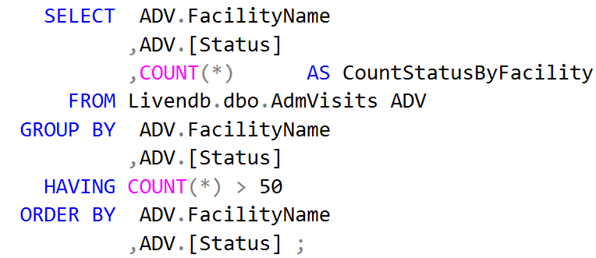
Core SQL Commands GROUP BY
Though many queries will not require GROUP BY and its attendant aggregates, there are times when they will be required.
To use SQL functions like SUM(), AVG() and COUNT() the GROUP BY clause will be required to be added to the end of the query with a grouping list. Each column in the grouping list must be listed in the column selection. Each column in the SELECT list must either be in the grouping list or must be created with an aggregate function.
HAVING is an additional clause, after the GROUP BY, which allows additional query filtering that depends on the results of one or more of the aggregates.
Notes:
GROUP BY on MSDN: http://msdn.microsoft.com/en-us/library/ms177673.aspx
HAVING on MSDN: http://msdn.microsoft.com/en-us/library/ms180199(v=sql.105)

Slide 30
Core SQL Date/Time Handling
Useful Date Functions
DATEADD | Allows addition/subtraction of time (years, months, days, hours, etc.)
DATEPART | Allows extraction of piece of a date (year, month, day, etc.)
DATENAME | Returns the name of a piece of a date as a string
CONVERT | Converts Date to String or String to Date based on style (if no style specified the system will attempt to determine)
GETDATE | Returns the current date/time
Determine the beginning of the day when given a date:
Determine the end of the day when given a date:
Notes:
Dates and Times in SQL Server: http://msdn.microsoft.com/en-us/library/ff848733
CAST and CONVERT on MSDN: http://msdn.microsoft.com/en-us/library/ms187928.aspx
TRY_CONVERT and TRY_CAST on MSDN: http://msdn.microsoft.com/en-us/library/hh230993 and
http://msdn.microsoft.com/en-us/library/hh974669

Slide 31
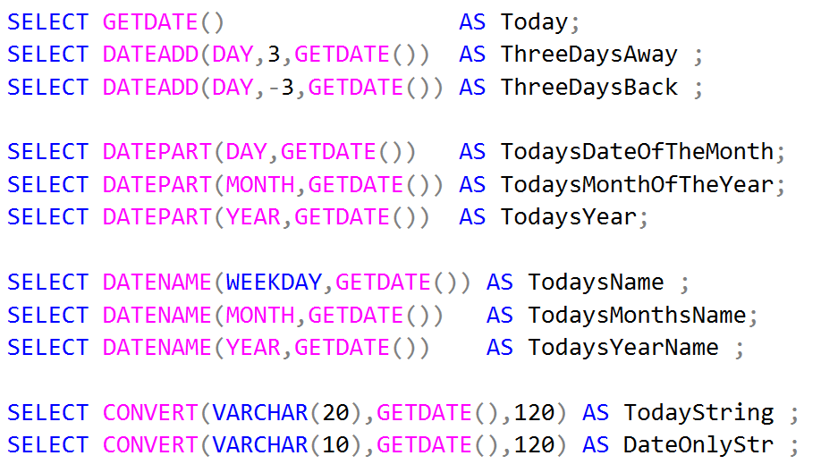
Date/Time Handling Review in SSMS

Slide 32
Core SQL JOIN
A JOIN allows for the retrieval of data from multiple tables based on the logical relationship between the tables. The logical relationship is based on specifying the relationship of the columns in the tables.
JOIN Types
INNER JOIN |  | Includes only rows that match condition in both tables
OUTER JOIN
 | LEFT | Includes all rows from the first table and only rows that match the condition from the secondary table
 | RIGHT | Includes only rows that match the condition from the first table and all the rows from the secondary table (reverse of LEFT)
 | FULL | Includes all rows from both tables
CROSS JOIN |  | Includes all rows from the first table. Each of the rows from the first table are combined will all the rows from the secondary table. These are also called Cartesian joins.
Notes:
Summary of the kinds of JOINs: http://sqlserverplanet.com/tsql/join-types

Slide 33
Core SQL JOIN
The two primary JOIN’s that will be used are the INNER JOIN (JOIN) and the LEFT OUTER JOIN (LEFT JOIN).
Within the Meditech system, always use the SourceID as part of the condition for the joining of the tables. This will insure not only that the correct records are matched, but that the query will use the Meditech created indexes on the tables. This will help with performance of the query.
When using the LEFT OUTER JOIN, the columns from the secondary table without a match will return a NULL value.
Note: Be cautious when using INNER JOIN when pulling data. This could cause dropped rows of data based on the join condition.

Slide 34
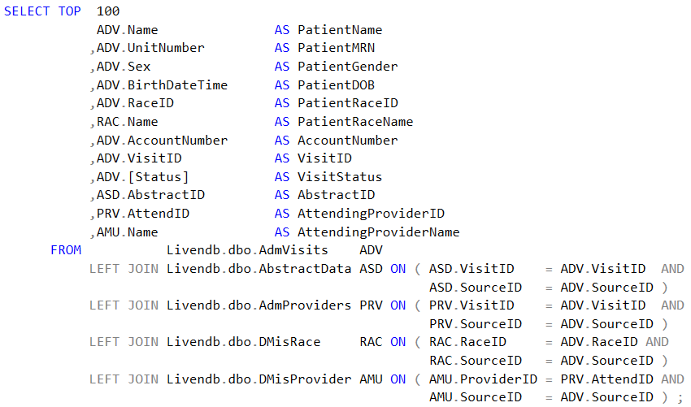
JOINs Review in SSMS

Slide 35
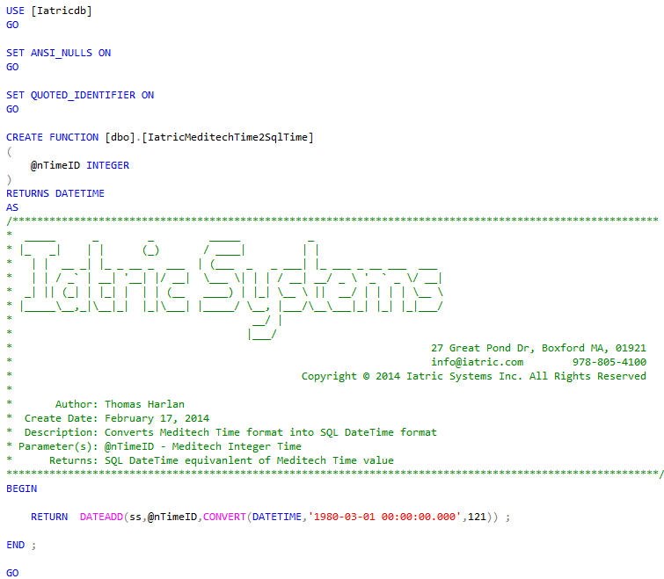
Core SQL Custom Functions
A custom function can be created to handle repetitive tasks and minimize the amount of program duplication. This also allows for the modification of code in one location.
Notes:
USE [Iatricdb]
GO
SET ANSI_NULLS ON
GO
SET QUOTED_IDENTIFIER ON
GO
CREATE FUNCTION [dbo].[IatricGetAge]
(
@dBirthDate AS DATETIME
,@dAsOf AS DATETIME
)
RETURNS VARCHAR(10)
AS
/*********************************************************************************************************
* _____ _ _ _____ _
* |_ _| | | (_) / ____| | |
* | | __ _| |_ _ __ _ ___ | (___ _ _ ___| |_ ___ _ __ ___ ___
* | | / _` | __| '__| |/ __| \___ \| | | / __| __/ _ \ '_ ` _ \/ __|
* _| || (_| | |_| | | | (__ ____) | |_| \__ \ || __/ | | | | \__ \
* |_____\__,_|\__|_| |_|\___| |_____/ \__, |___/\__\___|_| |_| |_|___/
* __/ |
* |___/
* 27 Great Pond Dr, Boxford MA, 01921
* info@iatric.com 978-805-4100
* Copyright © 2012 Iatric Systems Inc. All Rights Reserved
*
* Author: Thomas Harlan
* Create Date: February 17, 2014
* Description: Calculates patient age as of a point in time (defaulting to .now)
* Parameter(s): @dBirthDate - Birthdate of the person
* @dAsOf - Date when age is requested
* Returns: A text string with the following format:
* If patient is 6 years old or older, show: yyy
* If patient is between 1 and 6, show: yyyY mmM (zero filled)
* If patient is less than one, show: mmM ddD (zero filled)
**********************************************************************************************************/
BEGIN
-- Set up local storage
DECLARE @cAge AS VARCHAR(10) ;
DECLARE @dThisYearBirthDay AS DATETIME ;
DECLARE @nYearsOld AS INTEGER ;
DECLARE @nMonthsOld AS INTEGER ;
DECLARE @nDaysOld AS INTEGER ;
-- Check for a NULL As-Of-Date
IF ( @dAsOf IS NULL )
BEGIN
SET @dAsOf = GETDATE() ;
END;
-- Calculate markers
SET @dThisYearBirthDay = DATEADD(YEAR,DATEDIFF(YEAR,@dBirthDate,@dAsOf),@dBirthDate) ;
SET @nYearsOld = DATEDIFF(YEAR,@dBirthDate,@dAsOf) - (CASE WHEN @dThisYearBirthDay > @dAsOf THEN 1 ELSE 0 END) ;
SET @nMonthsOld = MONTH(@dAsOf - @dThisYearBirthDay) - 1 ;
SET @nDaysOld = DAY(@dAsOf - @dThisYearBirthDay) - 1 ;
-- Six years and older, show YYY (no zerofill, no prefix or suffix)
IF @nYearsOld >= 6
BEGIN
SET @cAge = CONVERT(VARCHAR(3),@nYearsOld) ;
END ;
-- If Between 1 and 5, show yY mmM
IF (@nYearsOld BETWEEN 0 AND 5 )
BEGIN
SET @cAge = CONVERT(VARCHAR(1),@nYearsOld)+'Y ' + RIGHT('0'+CONVERT(VARCHAR(2),@nMonthsOld),2) + 'M' ;
END ;
IF @nYearsOld = 0
BEGIN
SET @cAge = RIGHT('0'+CONVERT(VARCHAR(2),@nMonthsOld),2)+'M '+RIGHT('0'+CONVERT(VARCHAR(2),@nDaysOld),2)+'D' ;
END ;
RETURN @cAge ;
END ;
GO

Slide 36
Core SQL Using Custom Functions
Converting an internal Meditech date/time stored in a CDS response to a SQL date/time requires the knowledge of the process that Meditech utilizes. For this reason, a function can be used to hold the process in a single place.
Computing and displaying the patient age requires a custom function to match how Meditech displays age (nnn, yy mm, mm dd).

Slide 37
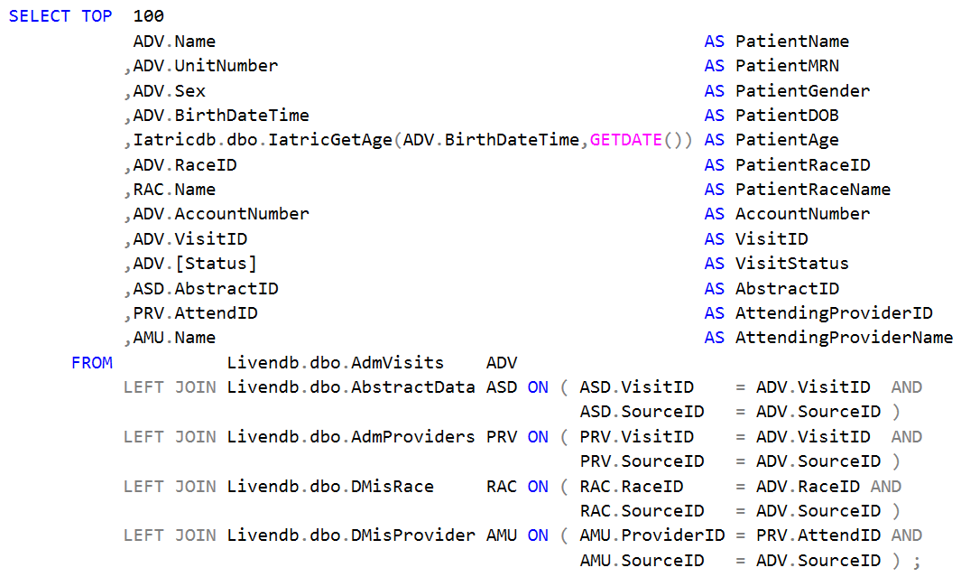
Using Custom Functions Review in SSMS

Slide 38
Core SQL Variables
The SQL engine can process a series of commands, which allows for the creation and population of variables prior to issuing a SELECT command.
Variables are created using a DECLARE statement with a name and a type.
If a default value is not assigned when the variable is created or the value needs to be modified, the SET command can be used to modify the value to a constant or the result of a SELECT statement (the SELECT statement can return an arbitrary result set of one row with one column only).
Notes:
The DECLARE statement: http://msdn.microsoft.com/en-us/library/ms188927.aspx
The SET statement: http://msdn.microsoft.com/en-us/library/ms189484

Slide 39
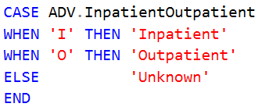
Core SQL CASE
Evaluates a list of conditions and returns one of multiple result expressions.
The CASE expression has two formats
The simple CASE expression compares an expression to a set of simple expressions to determine the result.
The searched CASE expression evaluates a set of Boolean expressions to determine the result.
Notes:
The COALESCE() function: http://msdn.microsoft.com/en-us/library/ms190349.aspx
The CASE/WHEN/END structure: http://msdn.microsoft.com/en-us/library/ms181765

Slide 40
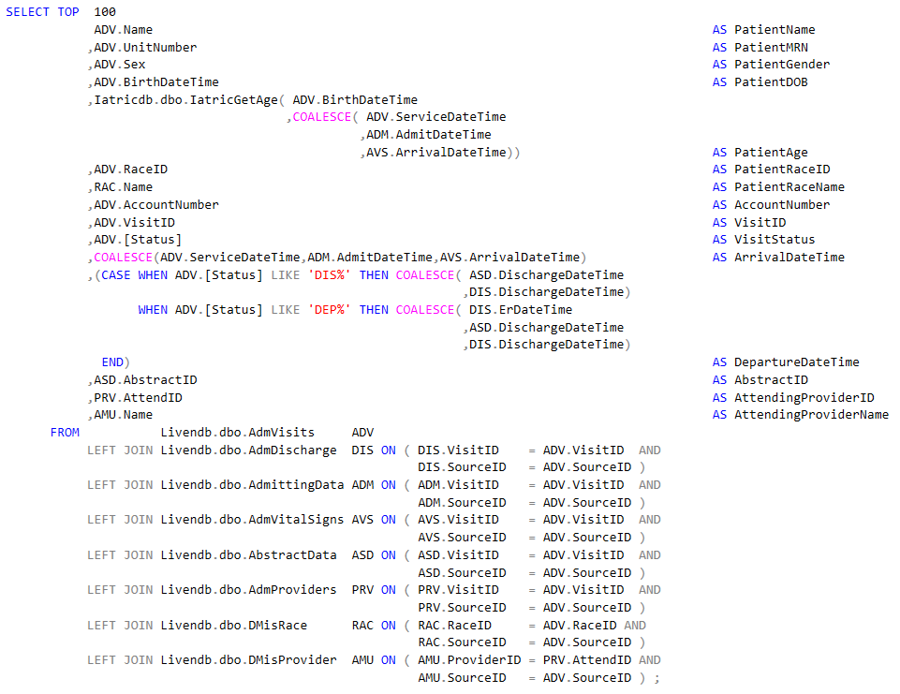
COALESCE and CASE Review in SSMS

Slide 41
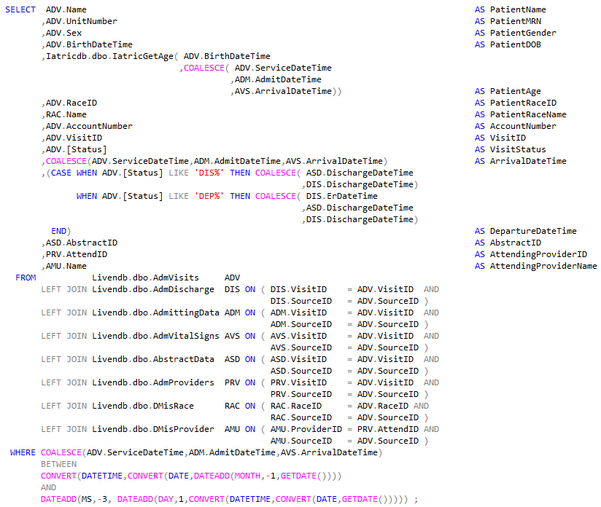
WHERE Review in SSMS

Slide 42
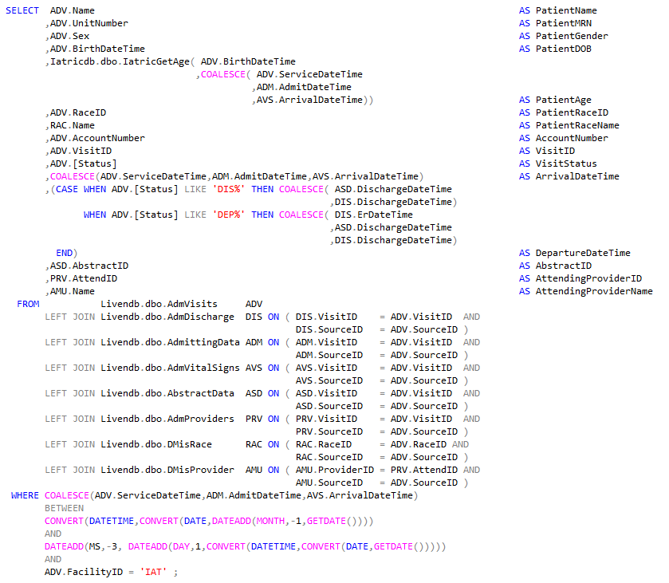
WHERE Review in SSMS

Slide 43
Core SQL Stored Procedures
A stored procedure is a group of SQL statements compiled into a single execution plan.
Returns data in four ways
Output parameters, which can return either data (such as an integer or character value) or a cursor variable (cursors are result sets that can be retrieved one row at a time).
Return codes, which are always an integer value.
A result set for each SELECT statement contained in the stored procedure or any other stored procedures called by the stored procedure.
A global cursor that can be referenced outside the stored procedure.
Notes:
CREATE STORED PROCEDURE on MSDN: http://msdn.microsoft.com/en-us/library/ms187926(v=sql.100).aspx
SET ANSI WARNINGS on MSDN: http://msdn.microsoft.com/en-us/library/ms190368.aspx

Slide 44
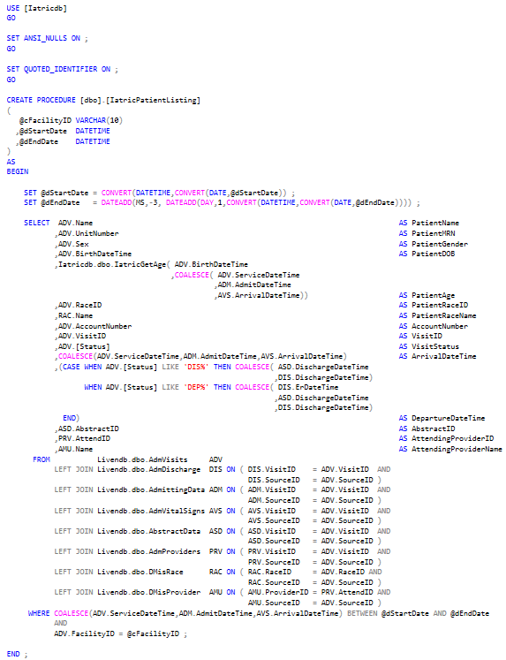
Stored Procedure Review in SSMS

Slide 45
Core SQL Stored Procedures
To run a stored procedure, the EXEC command is utilized.
EXEC <Catalog>.<Owner>.<Stored Procedure> Parameters
Note: Do not use a period within the naming. This can cause an issue unless you surround the name with brackets.

Slide 46
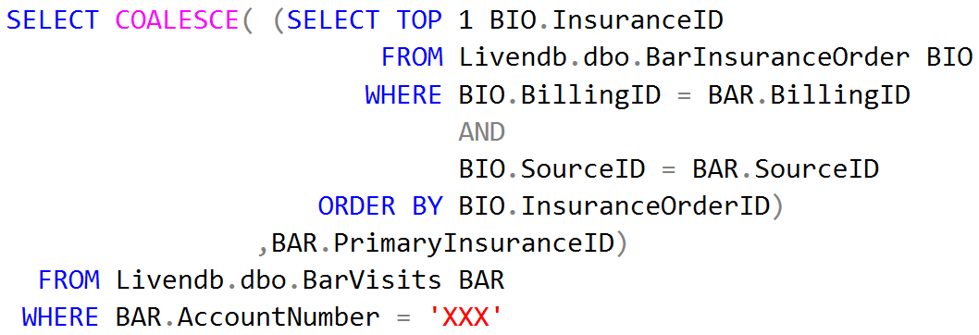
Core SQL Sub SELECT
On occasion there will be a need to return a field in the main SELECT which is the result of another SELECT statement.
Key points
Enclose the sub-query in parentheses
Tables in the sub-query require a unique alias
The WHERE of the sub-query is tied back to the parent query by aliased fields
Only one row with one column can be returned, thus the TOP 1, when using a sub-query as a column value.
Notes:
Subquery examples: http://www.akadia.com/services/sqlsrv_subqueries.html

Slide 47
Core SQL Delimited List
It is often useful to have a single field in a result set be a delimited list of values from another table ( like insurance mnemonics, ICD codes, etc. ). The are a variety of ways this can be done, but the one we suggest as a best practice is the FOR XML PATH clause with a sub-select.
Note that we use a STUFF() to trim off the leading pipe sign in the string and, since we are using FOR XML, we need to swap the “&amp;” tokens back to a regular “&” character.
Notes:
STUFF on MSDN: http://msdn.microsoft.com/en-us/library/ms188043.aspx
FOR XML PATH on MSDN: http://msdn.microsoft.com/en-us/library/ms190922.aspx
Examples: http://archive.msdn.microsoft.com/SQLExamples/Wiki/View.aspx?title=createacommadelimitedlist

Slide 48
Stored Procedure w/ Delimited List Review in SSMS
Update the previously created stored procedure with the coding for the Insurance Codes.
Since the stored procedure currently exists on the server, the CREATE will need to be replaced with ALTER.
Notes:
USE [Iatricdb]
GO
SET ANSI_NULLS ON ;
GO
SET QUOTED_IDENTIFIER ON ;
GO
ALTER PROCEDURE [dbo].[IatricPatientListing]
(
@cFacilityID VARCHAR(10)
,@dStartDate DATETIME
,@dEndDate DATETIME
)
AS
BEGIN
SET @dStartDate = CONVERT(DATETIME,CONVERT(DATE,@dStartDate)) ;
SET @dEndDate = DATEADD(MS,-3, DATEADD(DAY,1,CONVERT(DATETIME,CONVERT(DATE,@dEndDate)))) ;
SELECT ADV.Name AS PatientName
,ADV.UnitNumber AS PatientMRN
,ADV.Sex AS PatientGender
,ADV.BirthDateTime AS PatientDOB
,Iatricdb.dbo.IatricGetAge( ADV.BirthDateTime
,COALESCE( ADV.ServiceDateTime
,ADM.AdmitDateTime
,AVS.ArrivalDateTime)) AS PatientAge
,ADV.RaceID AS PatientRaceID
,RAC.Name AS PatientRaceName
,ADV.AccountNumber AS AccountNumber
,ADV.VisitID AS VisitID
,ADV.[Status] AS VisitStatus
,COALESCE(ADV.ServiceDateTime,ADM.AdmitDateTime,AVS.ArrivalDateTime) AS ArrivalDateTime
,(CASE WHEN ADV.[Status] LIKE 'DIS%' THEN COALESCE( ASD.DischargeDateTime
,DIS.DischargeDateTime)
WHEN ADV.[Status] LIKE 'DEP%' THEN COALESCE( DIS.ErDateTime
,ASD.DischargeDateTime
,DIS.DischargeDateTime)
END) AS DepartureDateTime
,ASD.AbstractID AS AbstractID
,PRV.AttendID AS AttendingProviderID
,AMU.Name AS AttendingProviderName
,InsuranceCodes = REPLACE(STUFF(( SELECT ' | '+COV.InsuranceID
FROM livedb.dbo.AdmInsuranceOrder COV
WHERE COV.VisitID = ADV.VisitID
AND
COV.SourceID = ADV.SourceID
ORDER BY COV.InsuranceOrderID ASC
FOR XML PATH( '' )),1,3, '' ),'&amp;','&')
FROM livedb.dbo.AdmVisits ADV
LEFT JOIN livedb.dbo.AdmDischarge DIS ON ( DIS.VisitID = ADV.VisitID AND
DIS.SourceID = ADV.SourceID )
LEFT JOIN livedb.dbo.AdmittingData ADM ON ( ADM.VisitID = ADV.VisitID AND
ADM.SourceID = ADV.SourceID )
LEFT JOIN livedb.dbo.AdmVitalSigns AVS ON ( AVS.VisitID = ADV.VisitID AND
AVS.SourceID = ADV.SourceID )
LEFT JOIN livedb.dbo.AbstractData ASD ON ( ASD.VisitID = ADV.VisitID AND
ASD.SourceID = ADV.SourceID )
LEFT JOIN livedb.dbo.AdmProviders PRV ON ( PRV.VisitID = ADV.VisitID AND
PRV.SourceID = ADV.SourceID )
LEFT JOIN livedb.dbo.DMisRace RAC ON ( RAC.RaceID = ADV.RaceID AND
RAC.SourceID = ADV.SourceID )
LEFT JOIN livedb.dbo.DMisProvider AMU ON ( AMU.ProviderID = PRV.AttendID AND
AMU.SourceID = ADV.SourceID )
WHERE COALESCE(ADV.ServiceDateTime,ADM.AdmitDateTime,AVS.ArrivalDateTime) BETWEEN @dStartDate AND @dEndDate
AND
ADV.FacilityID = @cFacilityID ;
END ;

Slide 49
Meditech Data Dictionaries Meditech NPR to DR Mapping
Meditech provides a data dictionary that is a listing of the tables and columns that can be transferred to the DR. This dictionary is stored as a set of DR tables that can be queried allowing for searches of the data elements using SQL language.
In each of the Meditech DR databases there will be two tables named SysDrTables and SysDrColumns. These tables define the columns in each table and table-level information.
Notes:
STUFF on MSDN: http://msdn.microsoft.com/en-us/library/ms188043.aspx
FOR XML PATH on MSDN: http://msdn.microsoft.com/en-us/library/ms190922.aspx
Examples: http://archive.msdn.microsoft.com/SQLExamples/Wiki/View.aspx?title=createacommadelimitedlist

Slide 50
Meditech Data Dictionary Review in SSMS

Slide 51
Questions

